Slide 1
Introducing
MoxiWorks
Productivity Pack
Corner
Your
Market

Slide 2

Continuing to UP the Game!
First Service Realty ERA is excited to announce the launch of the MoxiWorks product suite, offering additional ways to drive your success.

Slide 3
Coming soon:
New CRM and Agent Websites
Marketing Pack
Productivity Pack
LAUNCHED
LAUNCHED
MoxiPresent
A feature-stuffed, ultra-versatile real estate presentation builder.
MoxiImpress
Impressive marketing tools for agents that help increase productivity.
MoxiWebsites
An easy-to-use website builder to drive an unmistakable, accessible and inspiring online experience.
MoxiEngage
A CRM built specifically for real estate that encourages long-term lead nurturing.
Notes:
Remove products you are not offering at your company

Slide 4
Why It Matters
No additional cost to as part of your affiliation with First Service Realty ERA
Can help you sell more homes, make more money and add to your productivity
Can help save you time and simplify your world
Connects to existing brand tools
and services to create a simple, integrated solution
Gives you a competitive advantage so you can outshine the competition

Slide 5

A CRM built specifically for real estate that encourages long-term lead nurturing.

Slide 6

The CRM that’s proven to boost sales volumes by an average of 54%.*
1
*Based on a 2018 analysis done by MoxiWorks that measured productivity gain of MoxiEngage users based on level of usage across all its user base.

Slide 7


Slide 8
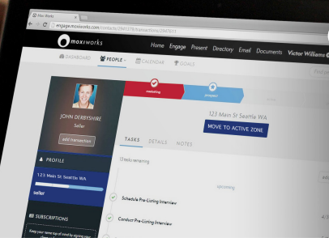
True Relationship Management
Contact management
Automated email marketing
Goal setting
MLS-integrated
Task recommendations & coaching
Seamless communication

Slide 9

An easy-to-use website builder for agents and teams to drive an unmistakable, accessible and inspiring online experience.
Notes:
Edit language if you are not moving forward with a broker website

Slide 10
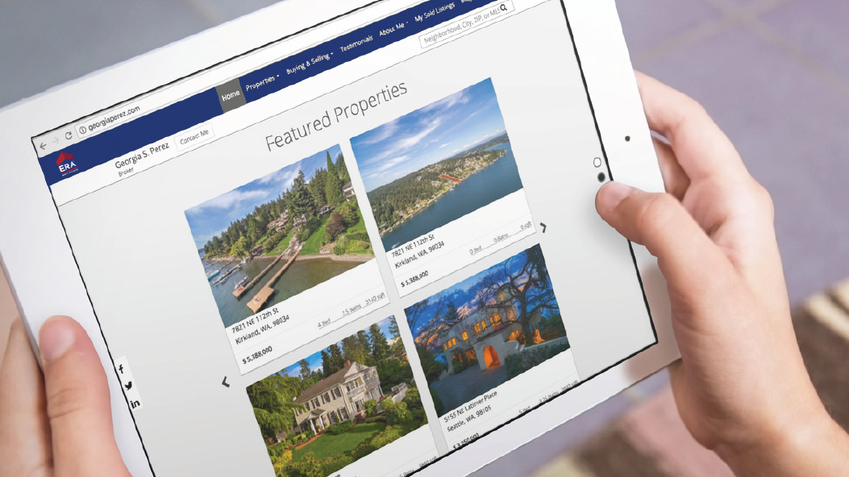
Driving Your
Business Online

Slide 11


Slide 12
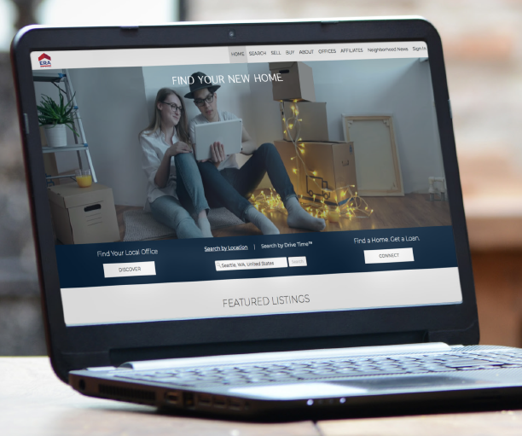
A Website In Just a Few Clicks
Lead capture
Integrated IDX search
Simple & easy-to-use
Intelligent web analytics
Branded
Responsive
Customizable
Blog-friendly

Slide 13
What to expect once you have access to MoxiWebsites
  Websites are provisioned using default domain structures approved by FSR-ERA for agent sites.
  At provisioning, you will have a stock website with FSR-ERA-provided branding, including:
    Details populated from profile information
    Contact forms
    Listing details
    Neighborhood news
    Profile creation for clients
    IDX search functionality
  Custom page options
  Testimonials and More

Slide 14

MOXI WORKS LAUNCH DATE is September 12, 2022!!!
Notes:
Please do not share your company launch timeline until you have received confirmation from the Realogy Product Team on when you will launch MoxiWorks at your company

Slide 15


FIRST SERVICE REALTY ERA
LAUNCHING SEPTEMBER 12th
APPROACH
PRE-LAUNCH
LAUNCH
POST-LAUNCH
6+ Weeks
4 Weeks
Ongoing
Get Prepared!
3-4 Weeks
Get Excited!
Keep it Going!
OBJECTIVE
Sign Up by August 30th!
Read all communications, which will outline next steps and any action items
Learn more about the product suite
Gain access to platforms
Training
Read all communications
Start using MoxiEngage on September 12
Start using MoxiWebsites September 12
Take advantage of self-paced learning and on-demand content via ERA University
Share your success stories
Ask if you need help!
KEY ACTIVITIES
Timeline subject to change
Notes:
Customize slide based on your specific company launch date

Slide 16
Product Launches and Training
Date | Event
August 30,2022 | MOXI ENGAGE & WEBSITE Sign Up Deadline
September 12, 2022 | MOXI WORKS Launch
Week of September 12, 2022 | MOXI WORKS Training become available
October 10,2022 | Provision MoxiEngage Data Migration Tool
Week of September 12, 2022 | MoxiWebsites Training
December 9, 2022 | Zap becomes read-only
Agent Training Session registrations will be available on the ERA University through Leverage

Slide 17

Training Opportunities
ERA Product training will be done virtually
FSR-ERA agents will also get in-person training.
Access to additional training resources including Getting Started Guide and
self-paced learning
(more resources will
be added throughout) via ERA University.
Training dates and times coming soon.
Notes:
Include dates and times of the training opportunities when/if available

Slide 18
ERA University
In addition to virtual training opportunities, ERA University features a variety of training materials that can be found on ERA University > Learning Library > Search for Moxi in the “Search Here” bar.
Resources include:
Getting started guides
Checklists
Instructions
Access to self-paced eLearning courses
Remember: Jany Walsh is our MoxiWorks Product Champion and can help to answer any questions
Notes:
Include dates and times of the training opportunities when/if available

Slide 19

Time to Get Ready
Important: For MOXI Engage (CRM) and Website to function, you must use the company- provided Office 365 email account.
Clean up your current email and mobile phone contacts to ensure the most accurate and up-to-date contacts will be migrated to MoxiEngage
You will have the option to migrate your Zap Contact Data or Market Leader Contact Data to MoxiEngage. It’s important to use this time to ensure those contacts are also accurate.
Check your email for training opportunities to learn how MoxiWorks can help boost your business!
Notes:
Please edit this slide specific to your company

Slide 20
One More Thing!
During this time, we are enhancing lead routing technology to Leads Engine. This should have minimal impact on your day-to-day.
We did want to share a few changes to be aware of as we start to transition to the new technology:
You can expect a new phone number (903-294-4442) to offer leads. Please add this phone number as a contact in your phone and set the new number with a special ringtone.
Lead details will be delivered to MoxiEngage and an email notification will also be sent to you from Leads Engine.

Slide 21
Questions?

