Slide 1



In your corner

Slide 2

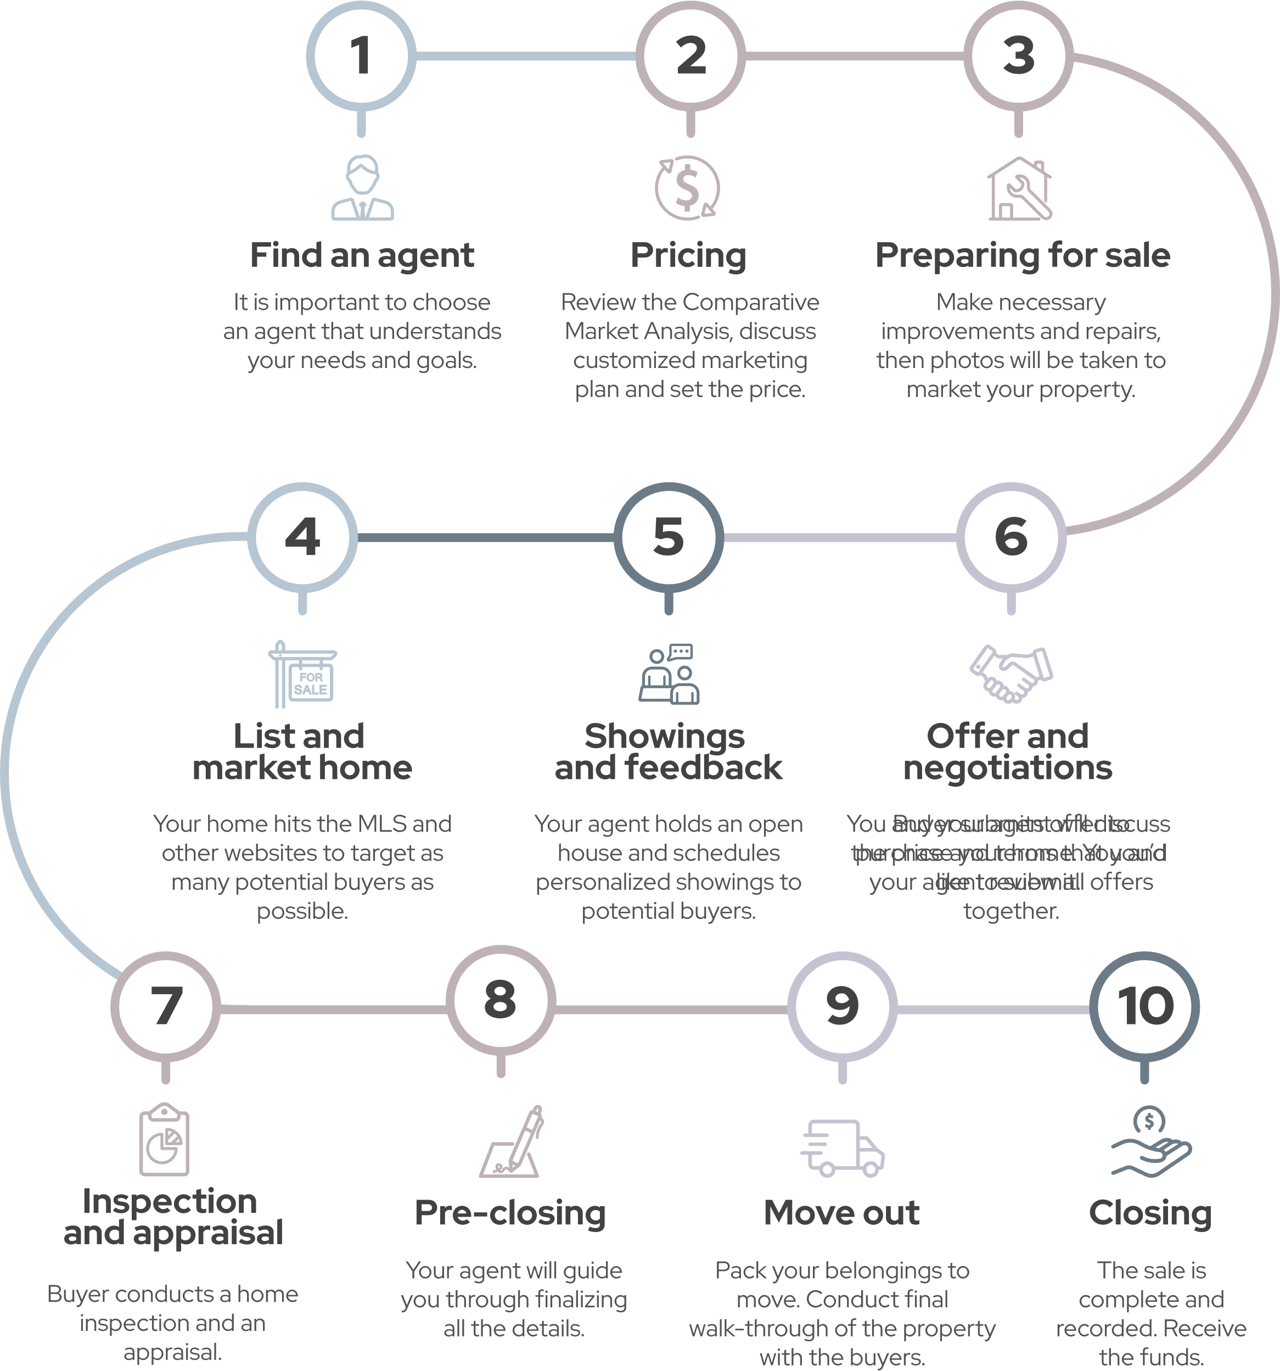
10 steps to selling
a home
Notes:
There several steps to selling a home, and it all starts with selecting the right agent. From getting your home ready to be listed, to showings and offers, to negotiating the best price and terms, my role doesn't stop once you find your buyer. I will be there at every step.

Slide 3


Let’s
do this
Why are you selling? Where are you moving?
Whatever the reason, being fully prepared to sell your house will help you maximize the price you get for your home, as well as helping you maintain your sanity along the way.
Timing
How soon do you need to move?
It is important to consider your financial situation, the cost of selling, and your ability to afford a new home. This will help you navigate the process seamlessly, from setting the price to closing the deal.
What’s Important
Price
Timing
Easy Transaction
Notes:
Ask questions to understand the seller’s motivation. You may have this information from a pre-listing call. If you already have this info, use this opportunity to recap what the seller has previously shared.
Seller Intel​:
Motivation​
Why are you selling?
Where are you moving?
How soon do you need to move?
What is most important to you? Price, timing? Easy transaction?
Ability​
How much equity do you have in the property?
How much of the proceeds from this house do you plan to use in the purchase of your next home?
Experience​
Have you ever sold a home before? In this area?
What did you like least and most about that experience and about the other agents you have worked with?
Property Intel​/Property Basics​: I am really looking forward to seeing your house. Can you tell me a little bit about it? Bedrooms, bathrooms, style, etc?
What is your favorite feature?
Have you already done any research on a price? (If yes), do you have a price in mind?

Slide 4


Let’s
get it sold
Challenges
What are the potential challenges you see with the home?
Recommend
Any insights to use certain spaces?
Selling Points
What do you consider the home’s best selling points?
Favorite
Features
What are your favorite features?
Upgrades
Have you done any upgrades to the home?
Notes:
Ask questions to understand the home’s best or unique selling features. You may have this information from a pre-listing call. If you already have this info, use this opportunity to recap what the seller has previously shared.
What do you consider the home’s best selling points?
What are your favorite features?
Are there any upgrades to the home?
Any insights to use certain spaces?
Are there any potential challenges you see with the home?

Slide 5


Marketing
Plan
Notes:
“I want to make sure that your initial market position will excite buyers strongly enough, so we can generate multiple showings and hopefully produce multiple offers. This marketing strategy is the best way to help you net the highest possible price with the fewest days on the market.”

Slide 6





Preparation
Staging
Photography
Video
Seller Incentives
Yard sign
Get your home
market ready
Schedule showings
Circle Prospecting
Consumer open house
Broker open house
Virtual open house
ERA Global Referral Network
Leveraging relationships
TextERA Code
ERA.com
MLS
Property website
Listing detail page
Listing distribution & SEM
Rapid response technology
Marketing your home
Social automation
Social boost
Email blasts
Flyers
Brochures
Postcards
Buyer incentives
Attracting buyers
Online analytics report
Buyer feedback
On-going Performance Analysis
Results
Notes:
“There are several steps we will take to market your home.”
Note: You can choose to discuss these at a high level or go into more detail depending on the seller’s level of interest.
Choose this slide for the high-level talk, or the more detailed slides that follow (or use both).

Slide 7

Steps to get your home
market ready
Seller Incentives
Video
Photography
Staging
Preparation
Notes:
Our goal will be to make your home appealing to the most buyers.
I’ll suggest changes you may consider to make your property market ready, like removing clutter, organizing, cleaning and repairs.
Staging helps neutralize the surrounding so that a buyer can envision the home as their own. It also helps make photos and video most appealing, and this is important because most home buyers start their search online. We can do this professionally or even virtually.
Photography is very important in marketing your property. Both the quality and the number of photos help buyers decide if they’re ready for the next stage of interest.
Your property will automatically get a virtual tour/YouTube video.
You have access to various seller incentives and programs, when you work with me.
ERA Home protection plan-A home warranty can help protect your budget and covered items while your home is on the market and can boost buyer confidence and help avoid stress over potential undetectable pre-existing conditions. It protects the house so a buyer can focus on making it a home.
Seller Security Plan-We are the only national real estate company that offers this, a guaranteed purchase plan offered nationwide.
Home Concierge-You will have access to Home Concierge, which is designed to be a convenient portal where you can get access to local, reputable contractors. Whether it is a small home improvement or a big renovation, ERA's Home Concierge portal helps you receive outstanding service and quality on every project.
ERA Moves-When you list with me, you will get access to ERA Moves, a pre-move program that saves you up to 25% during the course of your move and is designed to help ease the process of moving. It includes white-glove service and helps connect your utilities at your new home with one simple phone call. You’ll also receive e-mails from me with local and national offers to help you with your move, such as Home Depot, Bed Bath& Beyond, and 1-800-Got-JUNK.
Note: More detailed slides on seller programs are available in the appendix.

Slide 8


Leveraging
relationships
ERA Global Referral Network
Broker
Open House
Consumer
Open House
Stay Connected
Schedule Showings
Notes:
I will personally schedule all showings of your home with interested buyers.
I will diversify my contacts to residents around your listings through multiple marketing channels to be first of mind with neighbors in the community.
I’ll also host open houses. An open house will help us drive traffic and generate leads for your home.
I’ll leverage my agent relationships and host a Broker open house – one of their clients could be your buyer.
Buyers still use open houses to find a home, but they also heavily use technology – and we can use both to our advantage. In addition to holding a traditional open house, I can also host a video walk-through and even record a tour of your home and market that to prospective buyers.
With the ERA Global Referral Network I can broaden my reach and interest in your property across states and even countries. 14% of real estate transactions are out of state movers*, so I will have access to more Interstate Referral Business and even more international referral business.
*US Census Bureau Dec 2020

Slide 9
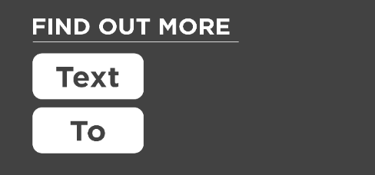
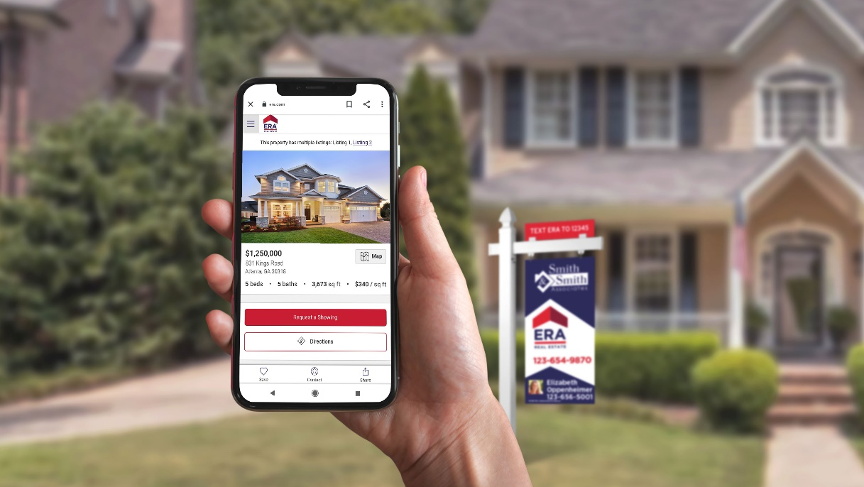
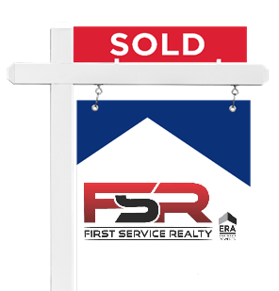


Marketing your home
ERA.com
FSRERA
35620
MLS
Rapid Response
Technology
Listing
Distribution & SEM
Property
Website
Notes:
Add a TextERA demo, to show how it works in real time. 60% of text leads convert into an actual showing
Text the word ERA [or your demo code] to 35620
Once the yard sign is in place, we’ll add TextERA. TextERA allows potential buyers to view property details and reach me via a text code. Buyers can simply text a keyword or number provided on your yard sign and they will receive information on your house directly back to their phone. TextERA also sends me an email with their contact information allowing me to capture them as a potential buyer for your house right from the curb.
ERA.com provides a dynamic, integrated lead-management system that combines marketing automation, customer relationship management, and actionable prospect data. Online requests from buyers are routed immediately via cell phone and email to me for instant follow up. It also tracks the source of all property leads so we can evaluate our marketing plan on an ongoing basis.
I’ll post your property on the MLS for additional exposure.
Your property will get its own website, in addition to its property detail page on ERA.com
We use search engine marketing (SEM) to drive traffic to ERA.com. Your listing will also be shared with over 200 of the most popular real estate websites in 20 countries around the globe.
Response time is equally as important as exposure. Rapid response technology allows me to receive instant notification when there’s an inquiry on your property.

Slide 10



Attracting buyers
Flyers
35620
Email Blasts
Brochures
Postcards
Buyer Incentives
Notes:
Add a TextERA demo, to show how it works in real time. 60% of text leads convert into an actual showing
Text the word ERA [or your demo code] to 35620
Once the yard sign is in place, we’ll add TextERA. TextERA allows potential buyers to view property details and reach me via a text code. Buyers can simply text a keyword or number provided on your yard sign and they will receive information on your house directly back to their phone. TextERA also sends me an email with their contact information allowing me to capture them as a potential buyer for your house right from the curb.
ERA.com provides a dynamic, integrated lead-management system that combines marketing automation, customer relationship management, and actionable prospect data. Online requests from buyers are routed immediately via cell phone and email to me for instant follow up. It also tracks the source of all property leads so we can evaluate our marketing plan on an ongoing basis.
I’ll post your property on the MLS for additional exposure.
Your property will get its own website, in addition to its property detail page on ERA.com
We use search engine marketing (SEM) to drive traffic to ERA.com. Your listing will also be shared with over 200 of the most popular real estate websites in 20 countries around the globe.
Response time is equally as important as exposure. Rapid response technology allows me to receive instant notification when there’s an inquiry on your property.

Slide 11

Results
Buyer
Feedback
Online
Analytics
Report
Social
Results
Ongoing Performance
Analysis
Notes:
I’ll share weekly online analytics reports through ListTrac and analyze the performance of our marketing. We will be able to see which sources are generating the most views and user engagements to better understand how much interest your home is generating amongst buyers. (Stand-alone Property Website and Automated tour – we can track traffic to it, and it’s a great way to aggregate data.)
With some of my previous listings, I was able to…(insert results/stats from past listings.) Because of these results, some of my clients said…(insert feedback from prior clients as examples).
Facebook ads brought in X amount of buyers, X amount of showings (snapshot of results from previous listings).
I’ll always share any feedback I get on your property so that we can strategically refine our plan.
Throughout the process, I will monitor sales conditions and interpret market indicators as they pertain to your listing's market position. Using many of the pre-listing analytic tools, such as the Competitive Marketing Analysis, the Pricing Grid, and other resources, I will continue to offer qualified advice to ensure your home remains in the most competitive position.
Go to https://leverage.era.com/content/era/en/content/agent-tools/listing-distribution.html to access listing distribution and reporting.

Slide 12


Determining your market position

Slide 13

Factors that influence
your home value
Age of home
Economic conditions
Neighborhood comps
Market conditions
Size
Livable space
Location
Condition
Notes:
Here is where you will show your CMA, any other pricing analysis tool you would like to use, and comps.
Your seller has probably done their research online and has an idea of the market and list price for their property. Remember, you are the professional. You can provide expert consultation, true local market knowledge, and the ability to effectively account for property specifics to determine the true market value of the home. Present your findings, and work in concert with the seller to arrive at a decision that is the natural result of your research and presentation.
“Pricing your property at fair market value, from the start, will generate the most activity from real estate agents and home buyers. The price must attract enough attention to result in showings and offers.
To determine the fair market value, we will go through a discovery process to account for the many factors that influence your home value. We will look at these factors together to help get your home ready for sale.”
Neighborhood comps: One of the best indicators of your home’s value is the sale price of similar homes in your neighborhood that have recently sold.
Size and livable space: Bigger homes tend to sell for higher prices
Age and Condition: Newer homes tend to sell for more than older homes because they typically require less maintenance. Updates can add value, especially in older, outdated homes.
Location: Where a property is located, in relation to good schools, shopping, highways and public transportation will affect the value.
Market conditions: Current supply of inventory versus buyer demand
Economic conditions: The status of the overall economy will factor into your home’s value.
“First, let’s look at the Competitive Market Analysis.” (Hand your client their personalized CMA that shows: recently sold homes, withdrawn, houses currently for sale and under contract.)
“The CMA takes recent data on houses that have and haven't sold to help us understand what the market is saying about the value of a house.
I want to make sure that your initial market position will excite the buyers strongly enough, so we can generate multiple showings and hopefully produce multiple offers. This strategy is the best way to help you net the highest possible price with the fewest days on the market.”
(Optional, you may already have this information in your CMA-full slide available in appendix. Otherwise use the ERA Pricing Analysis Suite and explain the results.) “With ERA’s Pricing Analysis Suite, we’ll get a clear picture of what buyers are willing to pay in today’s market, your competition, and most importantly what failed to sell. This is the data from the last 3 months for properties similar to yours. The green bar shows those that actually sold, which represents what buyers are expecting to pay and where properties similar to yours successfully appraised in today’s market. Also, many buyers look at multiple houses and compare them, so we need to look at the competition. This yellow bar represents the properties similar to yours that are currently on the market and which your property will compete against.”
“Lastly the red bar represents properties similar to yours that didn’t sell, meaning buyers said they wouldn’t pay this amount for a comp similar to yours in today’s market.”
(Optional, you may already have this information in your CMA. Full slide available in appendix.) “We also need to take into consideration the absorption rate. This is a critical number that helps determine the expected marketing time and calculates where to position your house in the marketplace in terms of price and condition to sell quickly.”
(Optional, you may already have this information in your CMA. Full slide available in appendix.) Average Sales Price
“As we know, pricing is one of the critical sales tools, and understanding the dynamics of pricing is essential to a successful sale. Let’s take a look at where your property falls in comparison to the average sales price for the marketplace.”
Now let’s take a look at comps.
(You may not want to build comps into the actual presentation, incase the property value changes once you do a walk through and the wide range of options that could exist. Possible solution is to have a range of comps, and pull out the ones that are relevant in real time.) The comps will help the seller understand how you’ve determined the fair market value.
“Let’s first look at homes most similar to yours in the area that are actively on the market, and then homes that have recently sold or are under contract, and lastly, expired listings. This will tell us which homes were perceived as a value and those that were not.”
You can help overcome objections by helping sellers understand the pricing strategy. Taking clients through the different factors that influence a home price, you have weaved in rationale for your pricing strategy to help overcome objections. Discuss your pricing strategy and enforce the point, let’s get it sold.
Access the ERA Pricing Analysis Suite here: https://leverage.era.com/content/era/en/content/marketing/listing-acquisition.html

Slide 14







Pricing Strategy
Pricing Right
While you and your agent will set your home’s asking price, the buyer will set the sales price. If you price your home too high, you will miss out on potential buyers. Pricing your property at fair market value, from the start, will generate the most activity from real estate agents and home buyers. The price must attract enough attention to result in showings and offers.
Asking Price:
Property Appeals to:
15% Over Market Value
20% of Buyers
10% Over Market Value
30% of Buyers
5% Over Market Value
50% of Buyers
Current Market Value
95% of Buyers
Notes:
“While you and I will set your home’s asking price, the buyer will set the sales price. If you price your home too high, you will miss out on potential buyers. Pricing your property at fair market value, from the start, will generate the most activity from real estate agents and home buyers. The price must attract enough attention to result in showings and offers.”

Slide 15

I’m in your corner
Preparing
Recommend how to get your home market ready
Complete listing documents and disclosures
Pricing
Thorough analysis of market
Set pricing strategy to achieve goals
Customized Marketing Strategy
Install ERA yard sign
Promote your home on the MLS
Syndicate your home’s listing to up to 200 websites
Respond to all buyer inquiries
Hold open house and arrange showings
Communicate feedback
Market your property via email, direct mail and social media
Provide market updates
Negotiation and
Closing
Evaluate offers and negotiate best price and terms
Facilitate inspections
Coordinate closing date, time, location and contacts
Monitor buyer financing and home appraisal
Follow up on details
Review closing statement
Close the sale
Notes:
This is your closure, so be sure to customize to show what makes YOU different. Focus on the customer service element you will be bringing to the relationship and that you are representing the sellers, be their advocates, and look out for their best interest.
“You can see there are a lot of steps along the way. From getting your home ready, to getting it listed, evaluating offers and negotiating the best price and terms, my role doesn’t stop once you find your buyer. I will be making sure every detail is handled correctly and in the necessary time frame until the keys are handed over. As your realtor, I will be here to help you through all of it.”

Slide 16

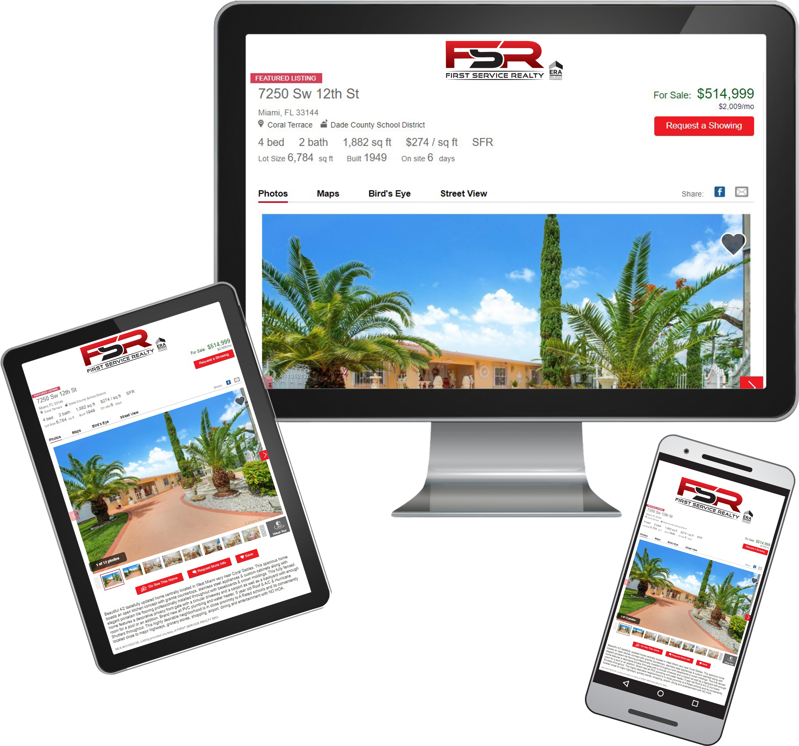
How We Market your Property
Every FSR-ERA® Listing† is converted to a virtual online tour
We create an individual website for your listing along with a YouTube video
YouTube has over a billion registered users and reaches more 18-49 year-olds than any cable network in the U.S.‡
Mobile friendly
Notes:
“ERA Real Estate is an established global brand for nearly 50 years, with a hyper local focus.
Being backed by a global brand gives us the technology to do more for our clients. We have access to massive lead generation tools to reach the right buyers, whether that means right here in your community or across the world. We also have access to over 200 of the most popular real estate websites in 20 countries to give your property the most market visibility, and to get your home seen by the most potential buyers.”

Slide 17

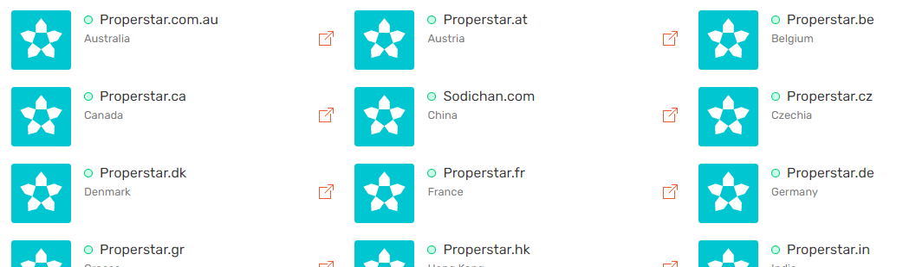
How We Market your Property Globally
Notes:
“ERA Real Estate is an established global brand for nearly 50 years, with a hyper local focus.
Being backed by a global brand gives us the technology to do more for our clients. We have access to massive lead generation tools to reach the right buyers, whether that means right here in your community or across the world. We also have access to over 200 of the most popular real estate websites in 20 countries to give your property the most market visibility, and to get your home seen by the most potential buyers.”

Slide 18

The power
of the brand

Slide 19




Realogy is in
our corner
11 Consecutive Years
Notes:
You can use this slide when you are discussing your brokerage and affiliation with the ERA® brand. This slide shows ERA’s parent company and the benefits that being part of the Realogy family brings to sellers.
“We are backed by Realogy Corporation, one of the leading and most integrated providers of residential real estate services in the U.S. Our relationship with them gives us the strength to focus on technology and products that are the most innovative in the industry to serve our clients better.”

Slide 20









Globally known
33
Countries
Worldwide
44
U.S.
States
200
U.S.
Companies
Over
13,350
U.S.
Agents
Approximately
2,350
Offices
Worldwide
Over
39,000
Agents
Worldwide
*Q4 2021 data
Notes:
ERA Real Estate is a global brand. This is important when it comes to selling your home because I can access new markets, and new buyers.
3% of all US residential real estate transactions are done by clients abroad - that’s over 150,000 transactions in a 12-month period*
39% of all reported transactions by international buyers were all cash sales*
International isn’t the only benefit, 14% of real estate transactions are out of state movers**. And by having a network in 35 countries, and 44 US states, I can tap into more buyers and draw more attention to you home to get it sold.
*2020 NAR International Transactions in U.S. Residential Real Estate Report
**US Census Bureau Dec 2020

Slide 21

Online &
In Your Corner
Focused on digital exposure to get homes sold
Listing Distribution
TOTAL
294.4M
Views
207M
Views
12M
Impressions
SEM
ERA YouTube Channels
8.9M
National Impressions
2.9M
Views
3.1M
Local Impressions
Social Automation
& Video Microsites
ERA.com
15M
Views
2.6M
Visits from
Organic Search
29.9M
Branded
Property Views
38M
Page Views
Based on internal and platform reporting for Jan 2020 – Dec 2020
Notes:
“Having a strong online presence is critical for marketing homes in today’s world. We are focused on digital exposure to get your home sold. Here is a snapshot of what that looks like.”
Sources:
2.6 million visits to ERA.com from organic search/Google Analytics “session views” January 1, 2020 -December 31, 2020
2.9 million listing views from ERA operated You Tube channels /*YouTube analytics January 1,2020 – December 31,2020
29,975,788 branded property views/*Google Analytics, ERA.com filtered by property detail pages combined with GA reporting for videos.ERA.com and SocialBoost internal reporting, January 1,2020 – December 31, 2020.
214,065 Leads/LeadRouter, January 1, 2020 – December 30, 2020
38,033,512 pageviews on ERA.com/Google Analytics “page views” January 1, 2020 -December 31, 2020
207,065,134 views through listing distribution /ListTrac internal report for total views, January 1, 2020 - December 31, 2020
8,972,414 national SEM impressions/*Internal reporting and Google Ads January 1, 2020 – December 31, 2020
3,100,100 local SEM impressions/*Based on local SEM and social media campaigns funded by brokers and run through the ERA local marketing platform. Internal reporting, Facebook, LinkedIn, Google Ads January 1, 2020 – December 31, 2020

Slide 22
Programs
available
for sellers
Notes:
You can use the following slides for your marketing section, if you qualify to use these programs.

Slide 23

Seller incentives
ERA Home
Protection Plan
ERA Moves
Home Concierge
by HomeAdvisor
You have options
Notes:
At ERA, we offer various programs to help sell your home and appeal to buyers.
*Check with your manager to see if you are a participating brokerage for these programs. Edit the programs that do not apply to you.

Slide 24
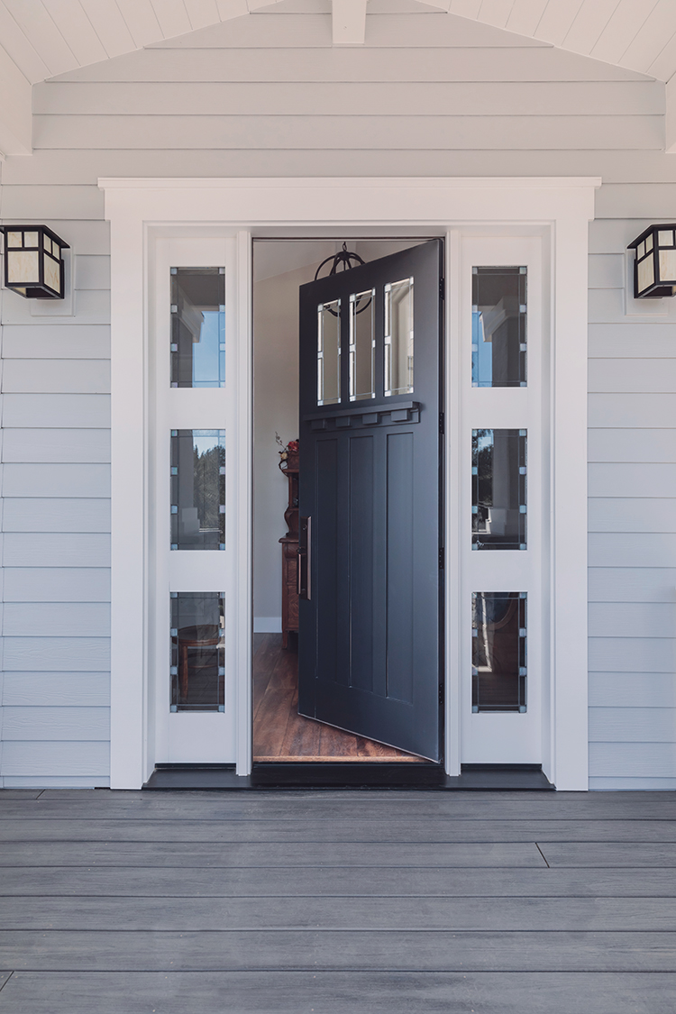



ERA Home
Protection Plan
A home protection plan can help protect your budget and covered items while your home is on the market and give you one less thing to worry about — knowing you’re protected against the expense of unexpected covered breakdowns.
Notes:
Benefits to Home Protection Plan for Sellers
-A home protection plan can mitigate unexpected issues from the home inspection and keep the sale on track.
-Boosts buyer confidence
-Minimal cost compared to appliance or system repairs
-Adds value and differentiation, and improves listing marketability
-Relief from unexpected, covered breakdowns while a house is on the market
-Reduce the need to negotiate price if an inspection finds problems
To Home Buyers:
An AHS warranty protects the house so a buyer can focus on making it a home. It can help them avoid stress over potential undetectable pre-existing conditions, like lack of maintenance and mismatched systems. Added confidence comes from AHS’s nationwide network of professional home repair experts, who are prescreened and monitored.
Provides repair solutions instead of repair stresses
Adds an expedited repair process on covered items
Budget protection during closing cash-crunch
Makes and offer stand-out in a competitive market.
For more information on this program visit: https://leverage.era.com/content/era/en/content/agent-tools/Home-Protection-Plan.html

Slide 25

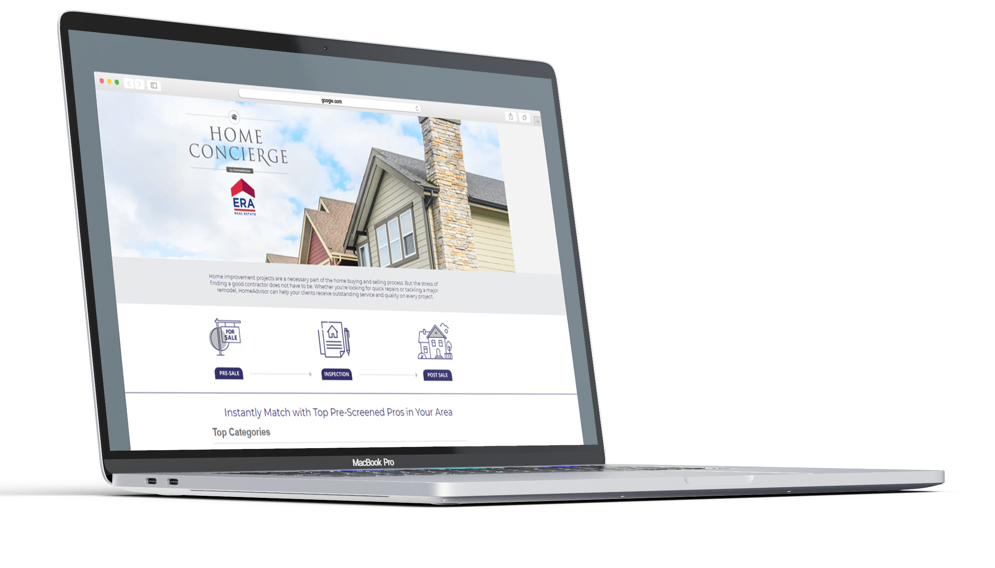
Home Concierge
by HomeAdvisor
Home improvement projects are a necessary part of the home buying and selling process. But the stress of finding a good contractor does not have to be. Whether you’re looking for quick repairs or tackling a major remodel, ERA's Home Concierge portal helps you receive outstanding service and quality on every project.
Notes:
You will have access to Home Concierge, which is designed to be a convenient portal where you can get access to local, reputable contractors.
Here is an example where you might want to mention or offer the benefits of Home Concierge:
“The market says this is what you need to do, to get the listing price/be competitive with the comps in the area. Through my company’s relationship with Home Advisor, I have access to contractors and service providers that can help get your home market-ready.”

Slide 26

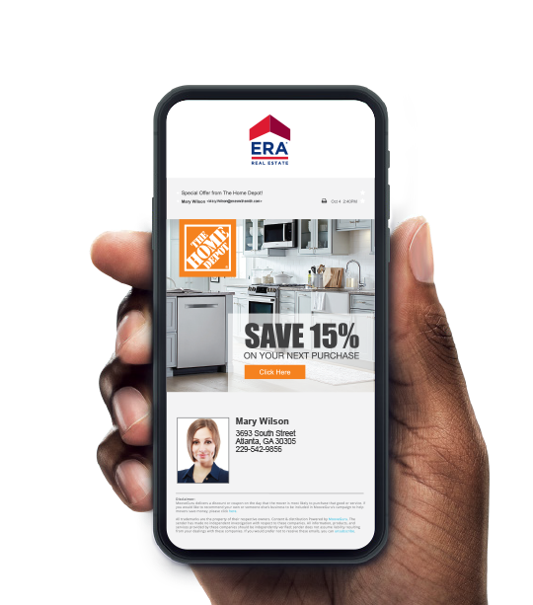




ERA Moves
Take the hassle out of moving.
Free and includes white-glove service that helps you connect all of your utilities with just one simple phone call.
Receive emails containing national money-saving offers from companies like Home Depot, Bed, Bath & Beyond and 1-800-Got-Junk as well as local offers.
Notes:
When you list with me, you will get access to ERA Moves, a pre-move program that saves you up to 25% during your move and is designed to help ease the process of moving. It includes white-glove service and helps connect your utilities at your new home with one simple phone call. You’ll also receive e-mails from me with local and national offers.
For more info on this program visit: https://leverage.era.com/content/era/en/content/agent-tools/era-moves.html

Slide 27
Attracting buyers
through marketing
Notes:
You can use the following slides for your marketing section, if you qualify to use these programs.

Slide 28

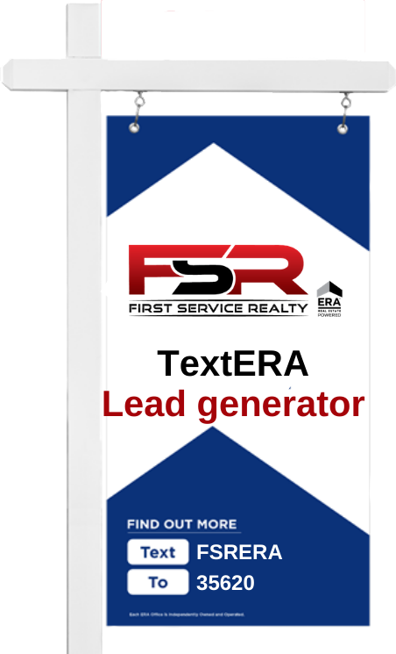
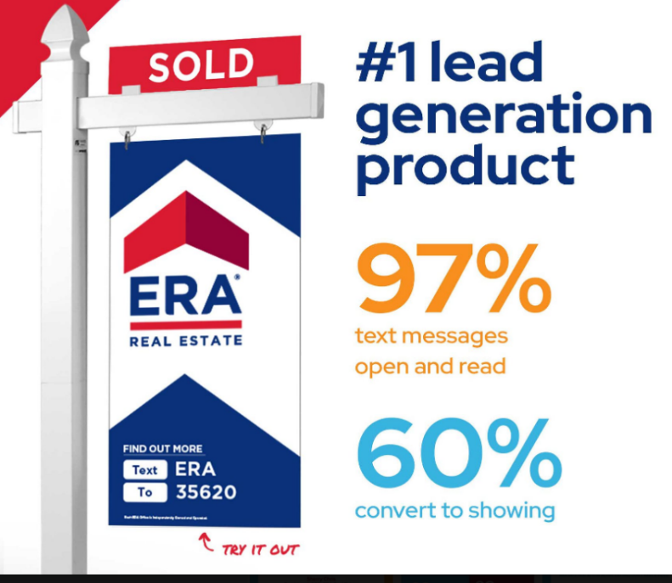

Our best lead generator
TextERA allows buyers to view property details and reach me via a text code. By texting a simple
code, potential buyers can express interest in your property in English or Spanish, and they will receive information about your home, and I can respond in a flash.
TextERA
Notes:
ERA is very focused on not only getting leads to you but leads that are more likely to convert.
97% of text messages are open and read and 60% have converted to showings.
Our TextERA product is our #1 lead generator.
We automatically generate keyword and codes for your property.
The TextERA keyword or code will appear on yard signs, and even my marketing materials.
Using the code, buyers can view property details immediately – and I’ll be notified.
All leads are automatically synced back to the CRM I use, to ensure I capture and convert each lead.
It’s a pretty amazing product. Give it a try right now. Text [your individualized company code] to 35620.
For more info on this program visit https://leverage.era.com/content/era/en/content/agent-tools/textera.html

Slide 29

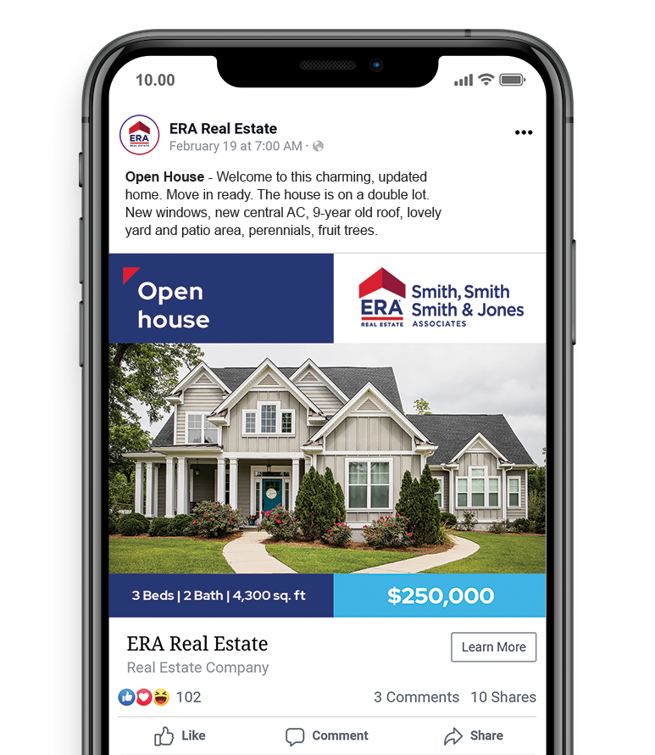

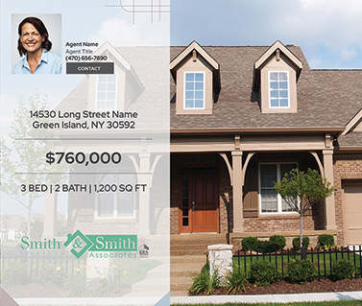

Social Media
Beyond connection
Social Automation
Social Automation automatically creates Just Listed and Open House videos for your property, then uploads it to my Facebook® and YouTube® pages. I can also post your listing on Pinterest, LinkedIn and Twitter.
Social Boost
Once the videos are on my brokerage’s Facebook page, I can easily target potential area home buyers outside of my sphere of influence using SocialBoost.
CAREER / BUSINESS MGMT
Notes:
Just Listed and Open House videos will be created for your property and uploaded to my brokerage’s Facebook and YouTube pages.
I can easily target potential homebuyers in your area, that I might not have been able to reach otherwise.
For more info on this program visit https://leverage.era.com/content/era/en/content/marketing/socialboost.html

Slide 30

Speed to lead
Rapid response to property inquiries
According to the National Association of REALTORS®, 97% of all buyers rely on the Internet as an information source in the home buying and selling process. These consumers expect and deserve a high level of customer service, including a prompt response, and that’s what they are going to get.
Notes:
According to the National Association of REALTORS®, 97% of all buyers- an all time high in 2020 - rely on the Internet as an information source in the home buying and selling process*. Buyers expect and deserve a high level of customer service, including a prompt response, and that’s what they are going to get.
I am available and able to accept leads whether it is through email, text, phone, chat box, all bases are covered.
*NAR 2020 Profile of Home Buyers and Sellers Report Nov

Slide 31

First Service Realty, In Your Corner
INTEGRITY, SERVICE AND EXPERIENCE
A team of Marketing Professionals and Managing Brokers working alongside our Real Estate Agents, providing operational excellence so that no detail is overlooked.
Our reputation and respected name along with our world class marketing programs, attract the most receptive buyers.
A First Service Realty Agent is an agent empowered by the First Service Realty and ERA Brand of Excellence.
Commitment
to service
Established in 1984
Notes:
If you are interested in using the Commitment to Service document in leverage, click here: https://leverage.era.com/content/era/en/content/marketing/listing-acquisition.html
Then select Commitment to Service in the drop-down menu and click download.
When you work with me, I am committed to providing you with the personalized service you deserve and delivering on your expectations, every step of the way. I will provide a comparative market analysis to determine the market value of your property. I will prepare an estimate of anticipated expenses, the estimated proceeds you could receive based on your asking or agreed-upon price. Not only that, I am committed to working together with you on a customized marketing plan to help sell your home, which includes at least XX photos that will be up on websites within X amount of days….”

Slide 32
Shall We Get Started?

