Slide 1





FSR + ERA
IN YOUR CORNER

Slide 2


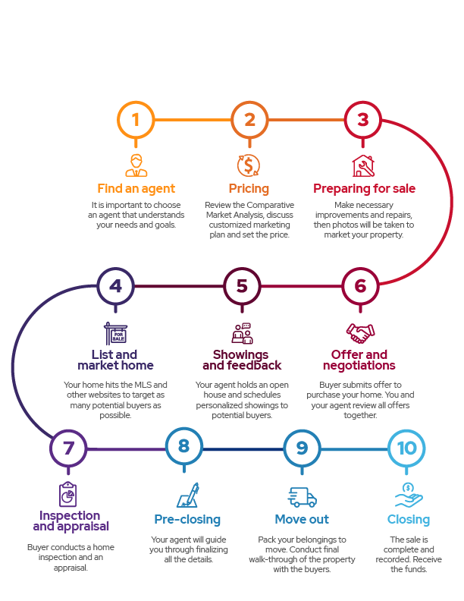





10 steps to selling
a home
Preparation
Staging
Photography
Video
Seller Incentives
Yard sign
Get your home
market ready
Schedule showings
Circle Prospecting
Consumer open house
Broker open house
Virtual open house
ERA Global Referral Network
Leveraging relationships
TextERA Code
ERA.com
MLS
Property website
Listing detail page
Listing distribution & SEM
Rapid response technology
Marketing your home
Social automation
Social boost
Email blasts
Flyers
Brochures
Postcards
Buyer incentives
Attracting buyers
Results
Online analytics report
Buyer feedback
On-going Performance Analysis
Notes:
“There are several steps we will take to market your home.”
Note: You can choose to discuss these at a high level or go into more detail depending on the seller’s level of interest.
Choose this slide for the high-level talk, or the more detailed slides that follow (or use both).

Slide 3

Let’s
do this
Why are you selling? Where are you moving?
Whatever the reason, being fully prepared to sell your house will help you maximize the price you get for your home, as well as helping you maintain your sanity along the way.
Timing
How soon do you need to move?
It is important to consider your financial situation, the cost of selling, and your ability to afford a new home. This will help you navigate the process seamlessly, from setting the price to closing the deal.
What’s Important
Price
Timing
Easy Transaction

Slide 4


Let’s
get it sold
Challenges
What are the potential challenges you see with the home?
Recommend
Any insights to use certain spaces?
Selling Points
What do you consider the home’s best selling points?
Social automation
Social boost
Email blasts
Flyers
Brochures
Postcards
Buyer incentives
Attracting buyers
Favorite
Features
What are your favorite features?
Results
Upgrades
Have you done any upgrades to the home?
Notes:
“There are several steps we will take to market your home.”
Note: You can choose to discuss these at a high level or go into more detail depending on the seller’s level of interest.
Choose this slide for the high-level talk, or the more detailed slides that follow (or use both).

Slide 5

Virtually
& in person
Communication
Marketing
Legal and
Financial Steps
Finalizing the Transaction

Slide 6


Marketing
Plan

Slide 7
Preparation
Staging
Photography
Video
Seller Incentives
Yard sign
Get your home
market ready
Schedule showings
Circle Prospecting
Consumer open house
Broker open house
Virtual open house
ERA Global Referral Network
Leveraging relationships
TextERA Code
ERA.com
MLS
Property website
Listing detail page
Listing distribution & SEM
Rapid response technology
Marketing your home
Social automation
Social boost
Email blasts
Flyers
Brochures
Postcards
Buyer incentives
Attracting buyers
Results
Online analytics report
Buyer feedback
On-going Performance Analysis
Notes:
“There are several steps we will take to market your home.”
Note: You can choose to discuss these at a high level or go into more detail depending on the seller’s level of interest.
Choose this slide for the high-level talk, or the more detailed slides that follow (or use both).

Slide 8
Steps to get your home
market ready
Seller Incentives
Video
Photography
Staging
Preparation

Slide 9





Leveraging
relationships
ERA Global Referral Network
Broker
Open House
Consumer
Open House
Stay Connected
Schedule Showings
Notes:
I will personally schedule all showings of your home with interested buyers.
I will diversify my contacts to residents around your listings through multiple marketing channels to be first of mind with neighbors in the community.
I’ll also host open houses. An open house will help us drive traffic and generate leads for your home.
I’ll leverage my agent relationships and host a Broker open house – one of their clients could be your buyer.
Buyers still use open houses to find a home, but they also heavily use technology – and we can use both to our advantage. In addition to holding a traditional open house, I can also host a video walk-through and even record a tour of your home and market that to prospective buyers.
With the ERA Global Referral Network I can broaden my reach and interest in your property across states and even countries. 15% of real estate transactions are out of state movers*, so I will have access to more Interstate Referral Business and even more international referral business.
*US Census Bureau Nov 2019

Slide 10
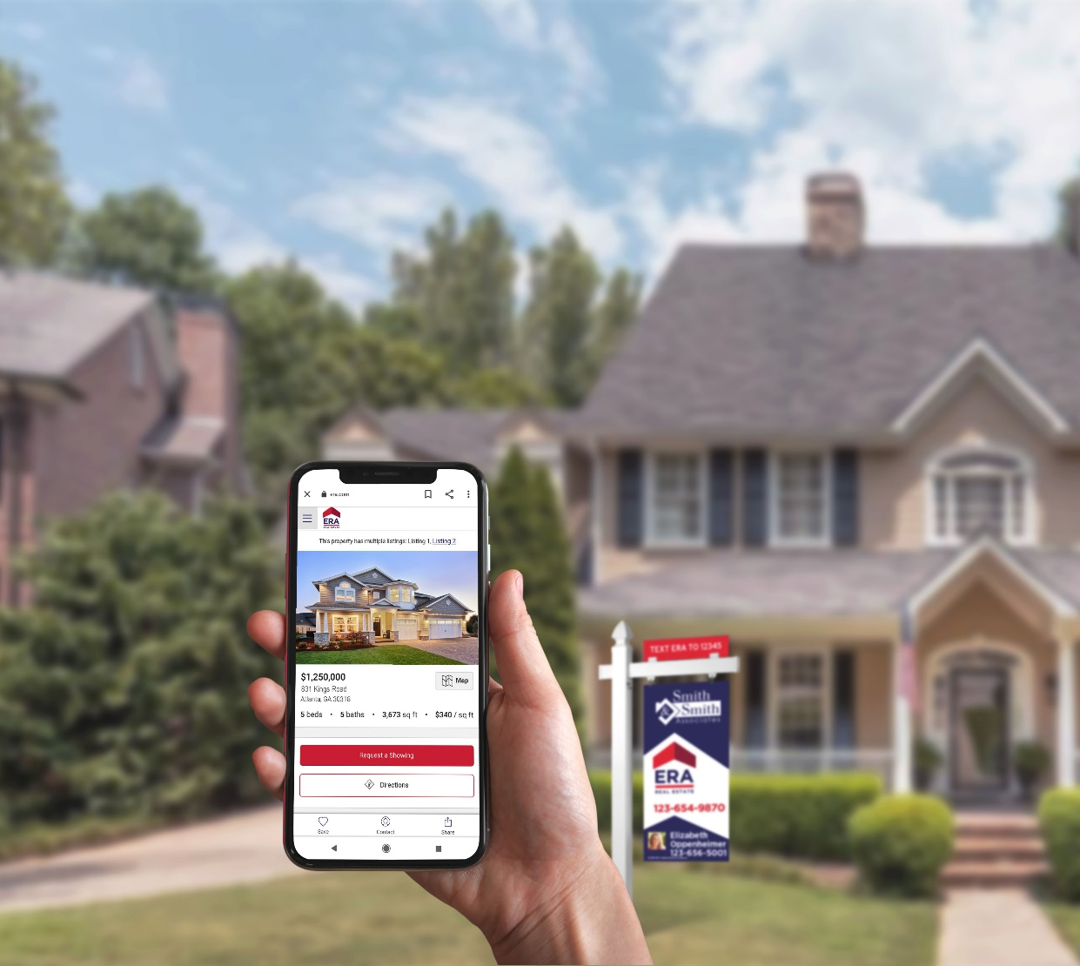




Marketing your home
FIND OUT MORE
FSR-ERA.com
Text
FSRERA
To
35620
MLS
MLS
Rapid Response Technology
Listing
Distribution & SEM
Property
Website
Notes:
Understanding Your Situation
Why are you selling?
Where are you moving?
When would you like to have your house sold?
What is driving your deadline?
What challenges do you anticipate having?
(Refer to ERA Effective Questioning Using the 4 C’s)
(After determining the sellers’ motivation, restate to them in order to confirm your understanding is correct.)
If Motivation is Time: So I will give you information and recommendations you need based on selling your house in (the timeframe they gave). Does that sound right?
If Motivation is Price: So I will give you information and recommendations you need based on selling your house in (the timeframe they gave), but getting your price is the most important factor. Does that sound right?

Slide 11



Attracting Buyers
Flyers
MLS
Email Blast
Brochures
Postcards
Buyer Incentives
Notes:
Understanding Your Situation
Why are you selling?
Where are you moving?
When would you like to have your house sold?
What is driving your deadline?
What challenges do you anticipate having?
(Refer to ERA Effective Questioning Using the 4 C’s)
(After determining the sellers’ motivation, restate to them in order to confirm your understanding is correct.)
If Motivation is Time: So I will give you information and recommendations you need based on selling your house in (the timeframe they gave). Does that sound right?
If Motivation is Price: So I will give you information and recommendations you need based on selling your house in (the timeframe they gave), but getting your price is the most important factor. Does that sound right?

Slide 12

Results
Buyer
Feedback
Online
Analytics
Report
Social
Results
Ongoing Performance
Analysis
Notes:
I’ll share weekly online analytics reports through ListTrac and analyze the performance of our marketing. We will be able to see which sources are generating the most views and user engagements to better understand how much interest your home is generating amongst buyers. (Stand-alone Property Website and Automated tour – we can track traffic to it, and it’s a great way to aggregate data.)
With some of my previous listings, I was able to…(insert results/stats from past listings.) Because of these results, some of my clients said…(insert feedback from prior clients as examples).
Facebook ads brought in X amount of buyers, X amount of showings (snapshot of results from previous listings).
I’ll always share any feedback I get on your property so that we can strategically refine our plan.
Throughout the process, I will monitor sales conditions and interpret market indicators as they pertain to your listing's market position. Using many of the pre-listing analytic tools, such as the Competitive Marketing Analysis, the Pricing Grid, and other resources, I will continue to offer qualified advice to ensure your home remains in the most competitive position.
Go to https://leverage.era.com/content/era/en/content/agent-tools/listing-distribution.html to access listing distribution and reporting.

Slide 13
Determining your
Market position

Slide 14
Factors that influence
your home value
Economic conditions
Age of home
Neighborhood comps
Market conditions
Size
Livable space
Location
Condition

Slide 15








Pricing Strategy
Pricing Right
While you and your agent will set your home’s asking price, the buyer will set the sales price. If you price your home too high, you will miss out on potential buyers. Pricing your property at fair market value, from the start, will generate the most activity from real estate agents and home buyers. The price must attract enough attention to result in showings and offers.
Asking Price:
Property Appeals to:
15% Over Market Value
20% of Buyers
10% Over Market Value
30% of Buyers
5% Over Market Value
50% of Buyers
Current Market Value
95% of Buyers
Notes:
Selling Your Property: Pricing – Competitive Market Analysis
Agents and companies have been using the Competitive Market Analysis for some time. What they look at is the recent data on houses that have sold and failed to sell. This will help understand what the market is saying about the value of your house.
**Copy and paste the link below into an internet browser to retrieve relevant trends, statistics and market conditions in your area: www.rrpr.com

Slide 16
I’m in your corner
Preparing
Recommend how to get your home market ready
Complete listing documents and disclosures
Pricing
Thorough analysis of market
Set pricing strategy to achieve goals
Customized Marketing Strategy
Install FSR-ERA yard sign
Promote your home on the MLS
Syndicate your home’s listing to up to 200 websites
Respond to all buyer inquiries
Communicate feedback
Market your property via email, direct mail and social media
Provide market updates
Negotiation and Closing
Evaluate offers and negotiate best price and terms
Facilitate inspections
Coordinate closing date, time, location and contacts
Monitor buyer financing and home appraisal
Follow up on details
Review closing statement
Close the sale
Notes:
Understanding Your Situation
Why are you selling?
Where are you moving?
When would you like to have your house sold?
What is driving your deadline?
What challenges do you anticipate having?
(Refer to ERA Effective Questioning Using the 4 C’s)
(After determining the sellers’ motivation, restate to them in order to confirm your understanding is correct.)
If Motivation is Time: So I will give you information and recommendations you need based on selling your house in (the timeframe they gave). Does that sound right?
If Motivation is Price: So I will give you information and recommendations you need based on selling your house in (the timeframe they gave), but getting your price is the most important factor. Does that sound right?

Slide 17
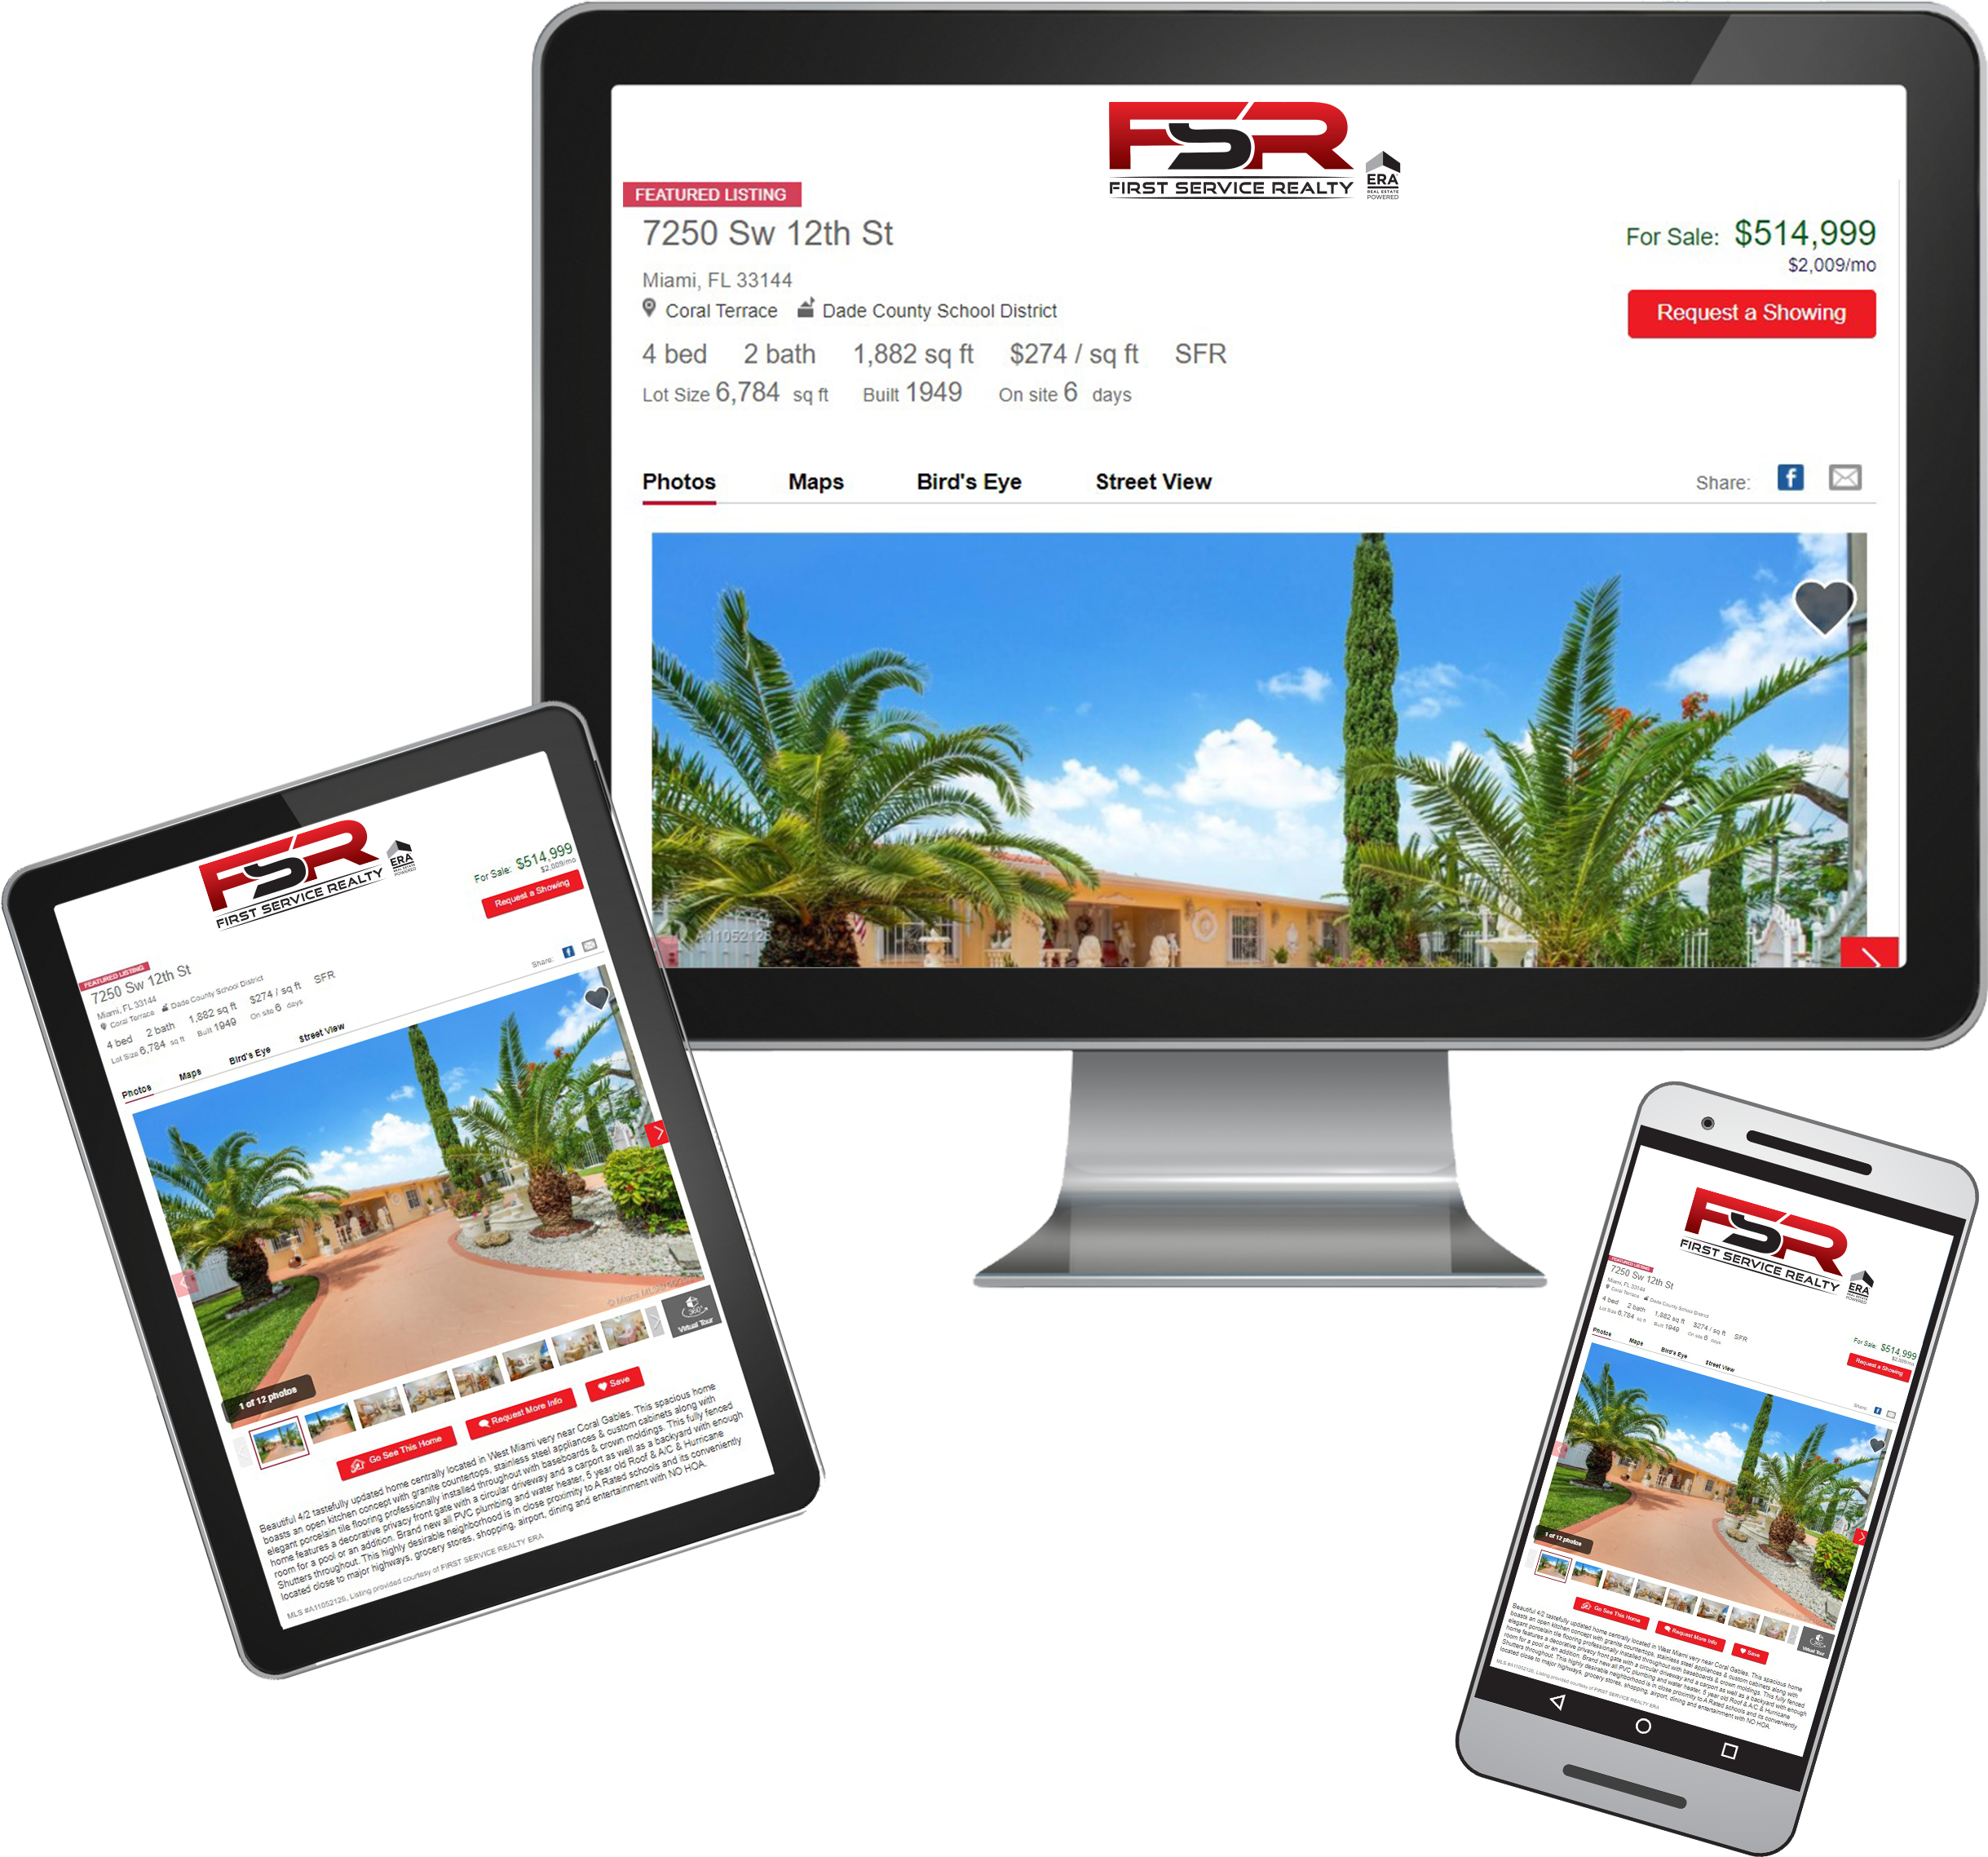
How We Market your Property
Every FSR-ERA® Listing† is converted to a virtual online tour
We create an individual website for your listing along with a YouTube video
YouTube has over a billion registered users and reaches more 18-49 year-olds than any cable network in the U.S.‡
Mobile friendly
Notes:
Selling Your Property: Marketing – YouTube Brand Channel & Video Websites
ERA (company name) has an online program with YouTube, and we will create a virtual tour of your property and post it on our channel. This video and its placement are designed to position your home in front of the millions of users within YouTube locally, out of state and internationally. Youtube is the 2nd largest search engine on the internet and it’s a destination site for home buyers. Simultaneously we will create a video website for your property that you can share on Facebook, twitter, google+ and Pinterest! And ERA distributes it to hundreds of real estate websites!

Slide 18

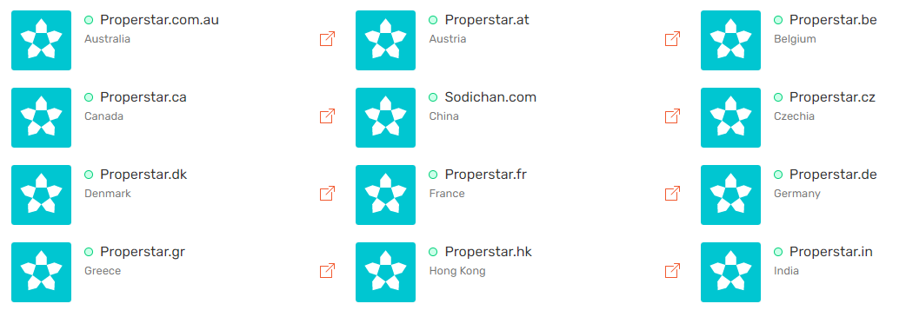
How We Market your Property Globally
Notes:
Selling Your Property: Marketing – YouTube Brand Channel & Video Websites
ERA (company name) has an online program with YouTube, and we will create a virtual tour of your property and post it on our channel. This video and its placement are designed to position your home in front of the millions of users within YouTube locally, out of state and internationally. Youtube is the 2nd largest search engine on the internet and it’s a destination site for home buyers. Simultaneously we will create a video website for your property that you can share on Facebook, twitter, google+ and Pinterest! And ERA distributes it to hundreds of real estate websites!

Slide 19


The power
of the brand

Slide 20

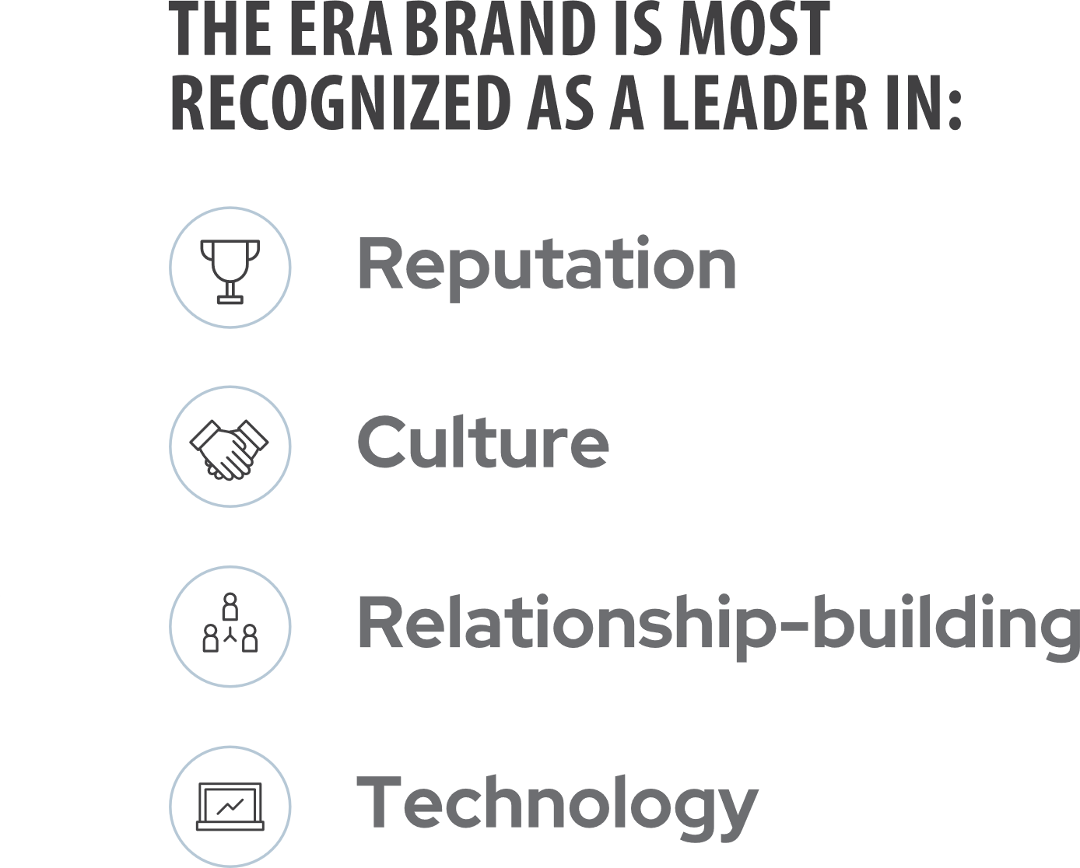

The power of the brand
Notes:
Selling Your Property: Marketing – Additional Marketing Opportunities
Along with the expansive internet presence and the ERA exclusive tools, we also have additional marketing opportunities we will be using to expose your house to the most potential buyers out there.
I am curious, of all the services we just covered, which one really caught your eye?
That is a tremendous service and only available through ERA (company name).

Slide 21









Globally known
33
Countries
Worldwide
44
U.S.
States
200
U.S.
Companies
Over
13,350
U.S.
Agents
Approximately
2,350
Offices
Worldwide
Over
39,000
Agents
Worldwide
*Q4 2021 data
Notes:
We’re also part of a global community of professionals who are invested in your success…

Slide 22
Online &
In Your Corner
Focused on digital exposure to get homes sold
Listing Distribution
TOTAL
294.4M
Views
207M
Views
12M
Impressions
SEM
ERA YouTube Channels
8.9M
National Impressions
2.9M
Views
3.1M
Local Impressions
Social Automation
& Video Microsites
ERA.com
15M
Views
2.6M
Visits from
Organic Search
29.9M
Branded
Property Views
38M
Page Views

Slide 23

Programs
available
for sellers
Notes:
Selling Your Property: Marketing – ERA Zap with instant lead notification
We have discussed the importance of exposure on the internet as well as immediate access to the potential buyers. With our ERA Zap website, online requests from buyers are routed immediately via cell phone and email to a real estate consultant for instant follow up.
This program also tracks the source of all property leads so we can evaluate our marketing plan on an ongoing basis.
Do you think an immediate response to a potential buyer will dramatically increase the odds of generating a showing?

Slide 24
Seller incentives
ERA Home
Protection Plan
ERA Moves
Home Concierge
by HomeAdvisor
You have options
Notes:
Selling Your Property: Marketing – Additional Marketing Opportunities
Along with the expansive internet presence and the ERA exclusive tools, we also have additional marketing opportunities we will be using to expose your house to the most potential buyers out there.
I am curious, of all the services we just covered, which one really caught your eye?
That is a tremendous service and only available through ERA (company name).

Slide 25



ERA Home
Protection Plan
A home protection plan can help protect your budget and covered items while your home is on the market and give you one less thing to worry about — knowing you’re protected against the expense of unexpected covered breakdowns.
Notes:
Selling Your Property: Marketing – ERA Zap with instant lead notification
We have discussed the importance of exposure on the internet as well as immediate access to the potential buyers. With our ERA Zap website, online requests from buyers are routed immediately via cell phone and email to a real estate consultant for instant follow up.
This program also tracks the source of all property leads so we can evaluate our marketing plan on an ongoing basis.
Do you think an immediate response to a potential buyer will dramatically increase the odds of generating a showing?

Slide 26
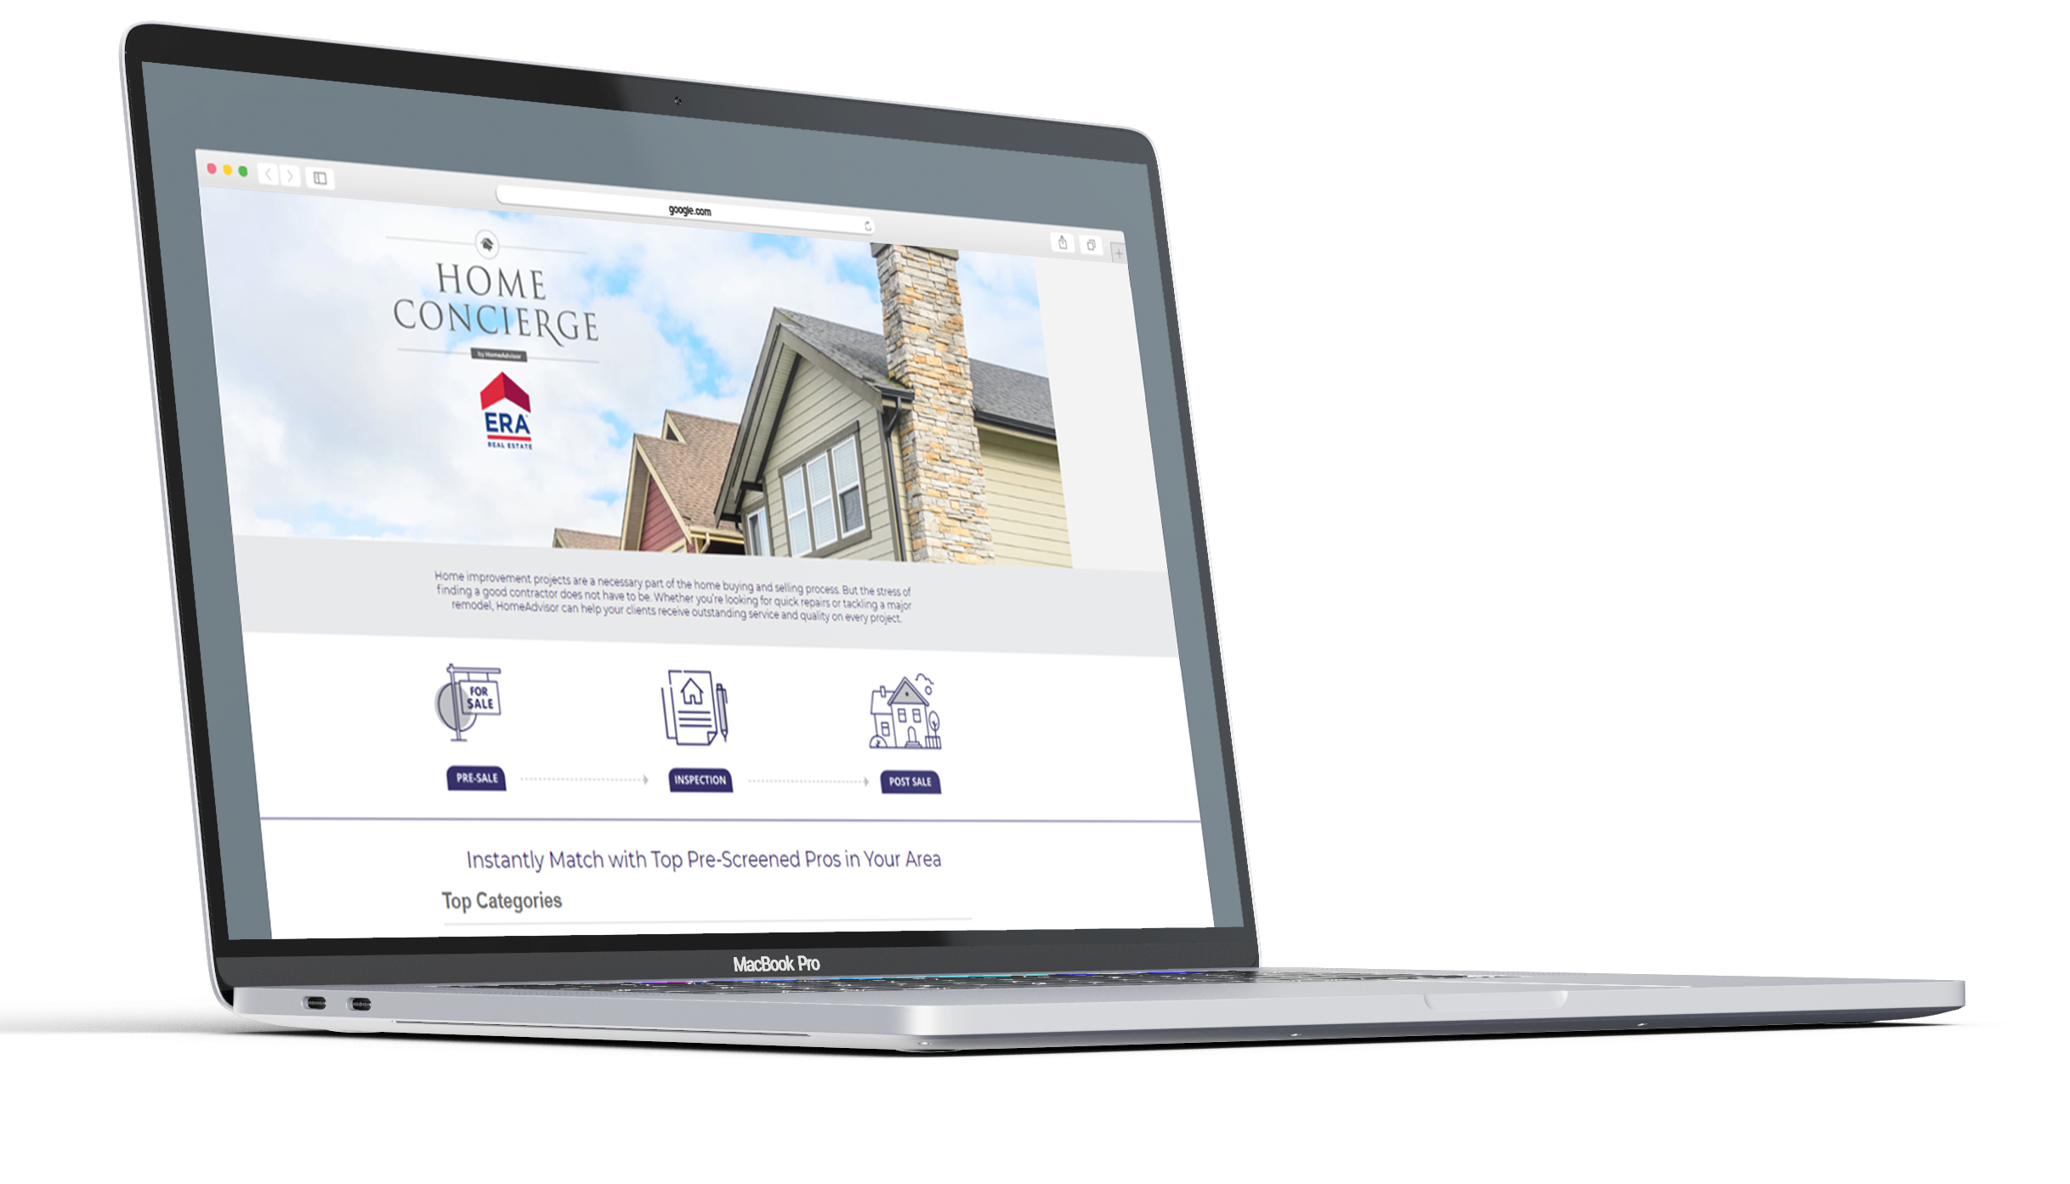
Home Concierge
by HomeAdvisor
Home improvement projects are a necessary part of the home buying and selling process. But the stress of finding a good contractor does not have to be. Whether you’re looking for quick repairs or tackling a major remodel, ERA's Home Concierge portal helps you receive outstanding service and quality on every project.
Notes:
Selling Your Property: Marketing – ERA Zap with instant lead notification
We have discussed the importance of exposure on the internet as well as immediate access to the potential buyers. With our ERA Zap website, online requests from buyers are routed immediately via cell phone and email to a real estate consultant for instant follow up.
This program also tracks the source of all property leads so we can evaluate our marketing plan on an ongoing basis.
Do you think an immediate response to a potential buyer will dramatically increase the odds of generating a showing?

Slide 27

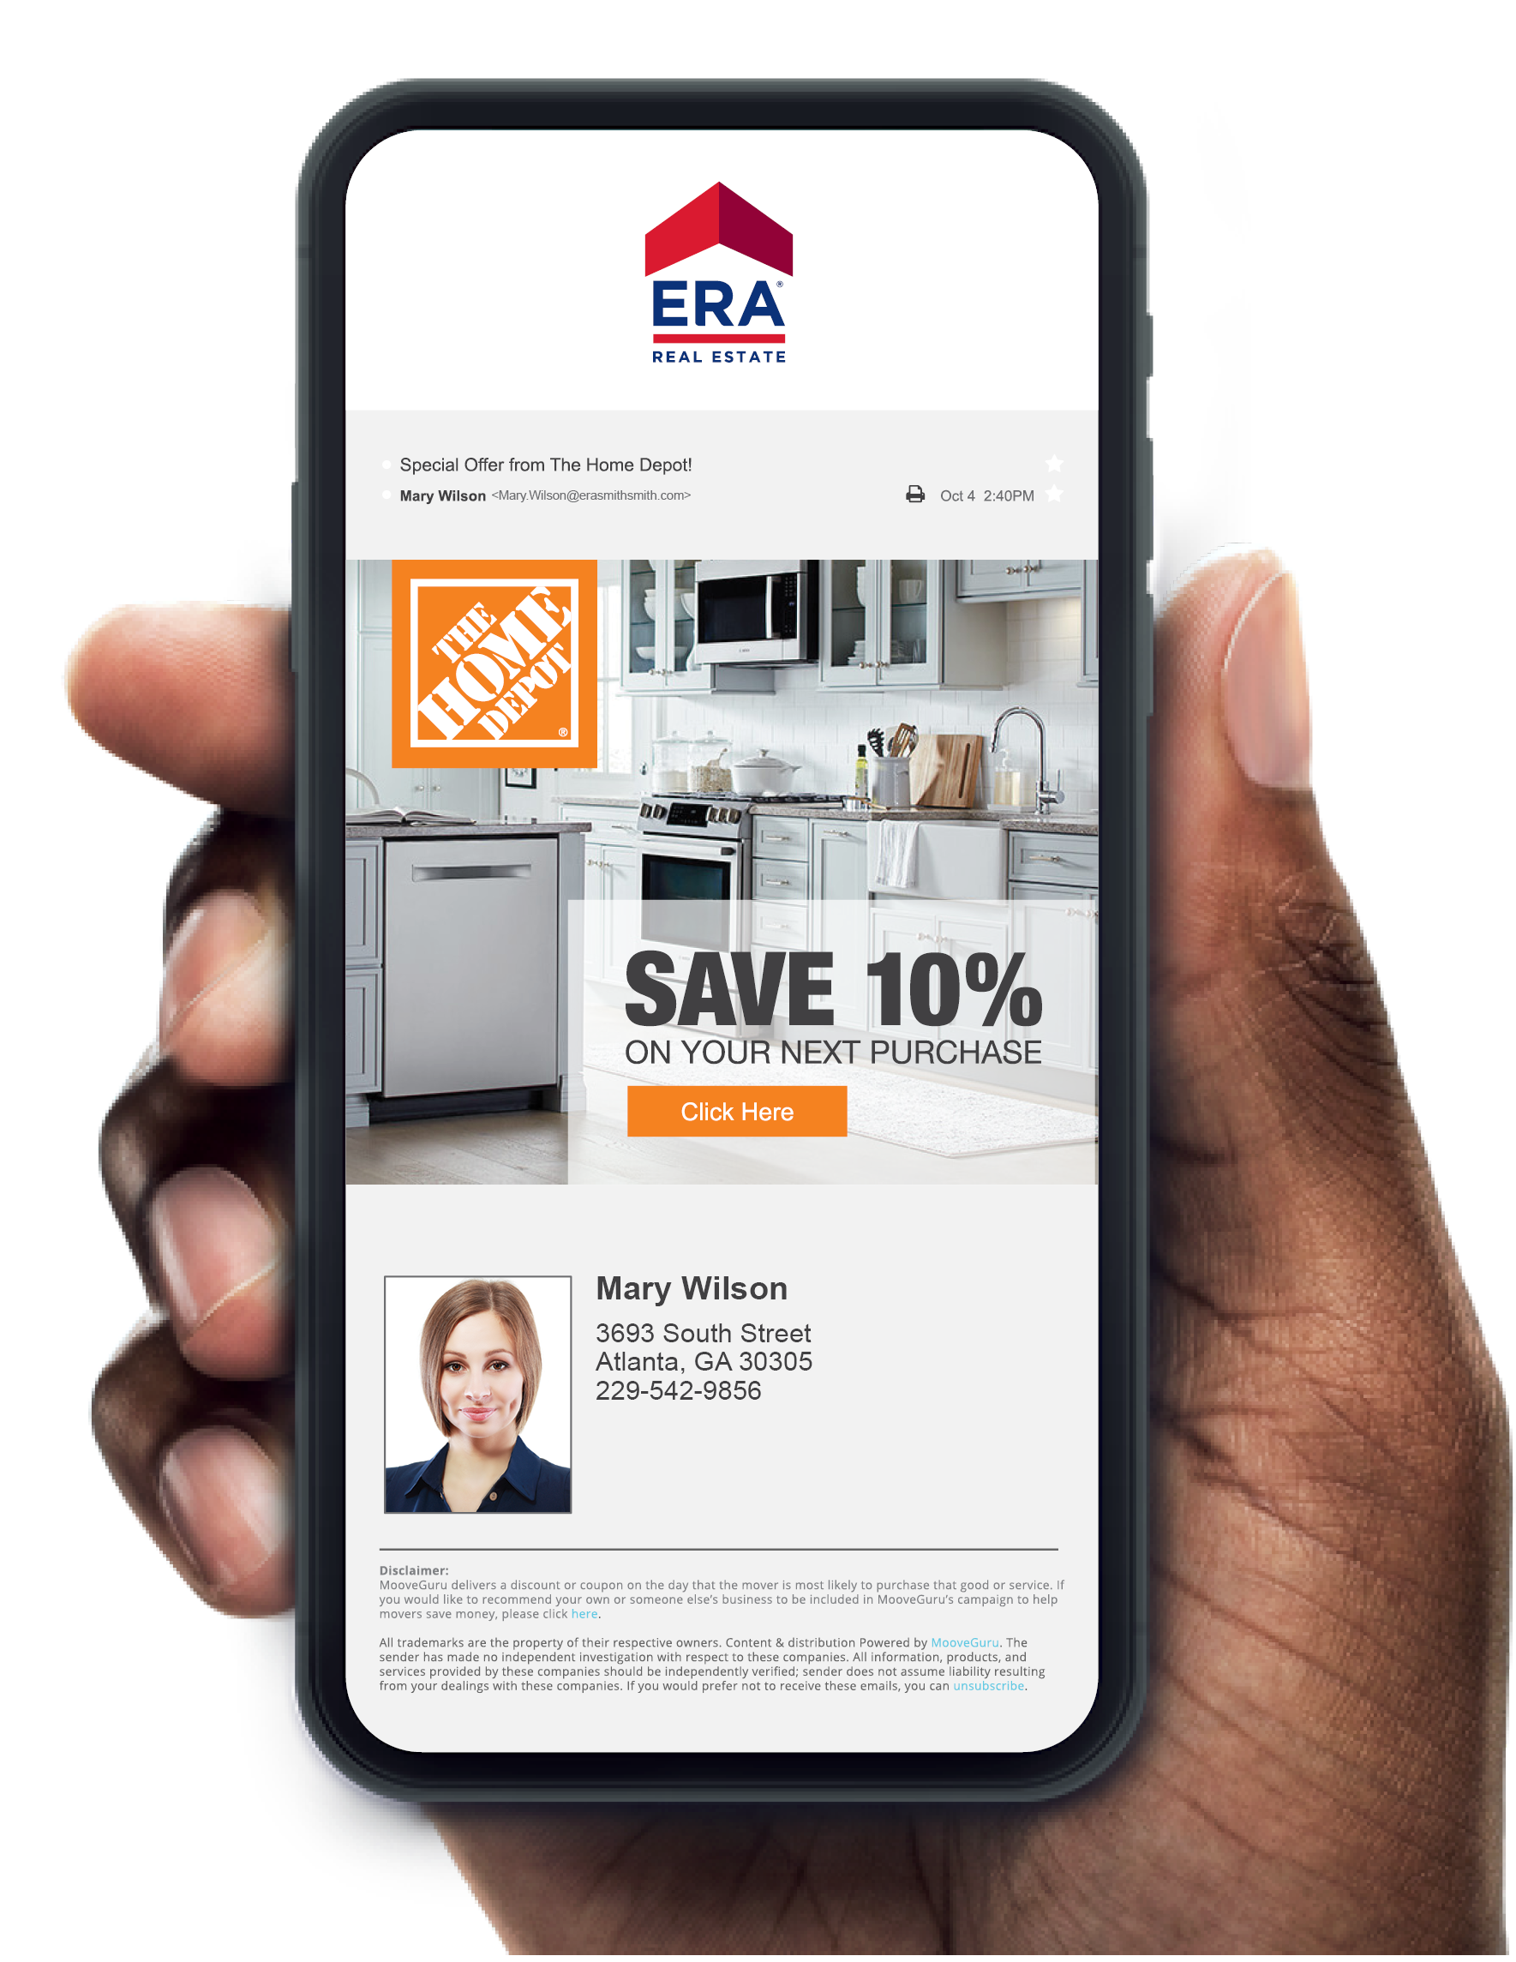


ERA Moves
Take the hassle out of moving.
Free and includes white-glove service that helps you connect all of your utilities with just one simple phone call.
Receive emails containing national money-saving offers from companies like Home Depot, Bed, Bath & Beyond and 1-800-Got-Junk as well as local offers.
Notes:
About the ERA Agent. This can be used either in the beginning of the presentation, at the end, or even spread out through out.

Slide 28
Attracting buyers
through marketing
Notes:
Selling Your Property: Marketing – ERA Zap with instant lead notification
We have discussed the importance of exposure on the internet as well as immediate access to the potential buyers. With our ERA Zap website, online requests from buyers are routed immediately via cell phone and email to a real estate consultant for instant follow up.
This program also tracks the source of all property leads so we can evaluate our marketing plan on an ongoing basis.
Do you think an immediate response to a potential buyer will dramatically increase the odds of generating a showing?

Slide 29



Our best lead generator
TextERA allows buyers to view property details and reach me via a text code.
By texting a simple code, potential buyers can express interest in your property in English or Spanish, and they will receive information about your home, and I can respond in a flash.
97%
text messages
open and read
60%
convert to showing
TextERA
Notes:
Selling Your Property: Marketing – Additional Marketing Opportunities
Along with the expansive internet presence and the ERA exclusive tools, we also have additional marketing opportunities we will be using to expose your house to the most potential buyers out there.
I am curious, of all the services we just covered, which one really caught your eye?
That is a tremendous service and only available through ERA (company name).

Slide 30
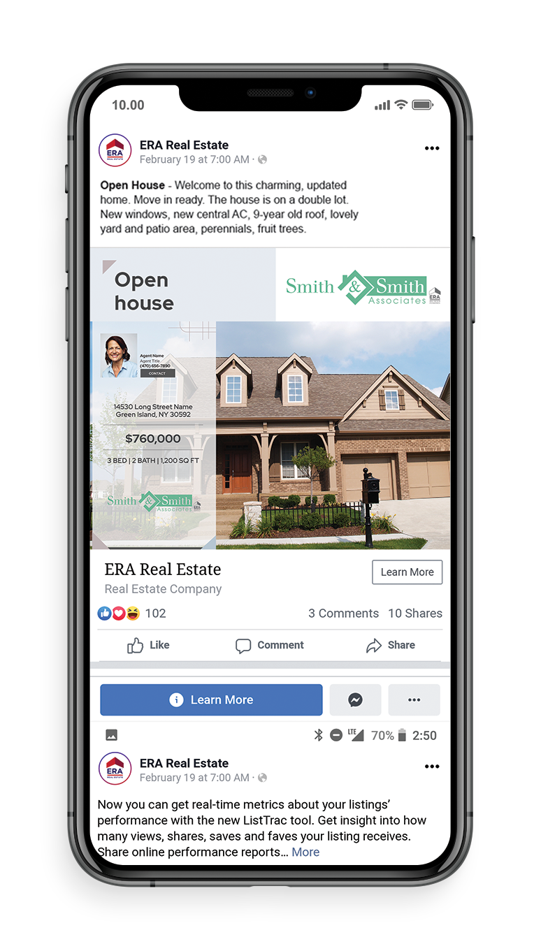

Social Media
Beyond connection
Social Automation
Social Automation automatically creates Just Listed and Open House videos for your property, then uploads it to my brokerage’s Facebook® and YouTube® pages.
Social Boost
Once the videos are on my brokerage’s Facebook page, I can easily target potential area home buyers outside of my sphere of influence using Social Boost.
Notes:
Selling Your Property: Marketing – Additional Marketing Opportunities
Along with the expansive internet presence and the ERA exclusive tools, we also have additional marketing opportunities we will be using to expose your house to the most potential buyers out there.
I am curious, of all the services we just covered, which one really caught your eye?
That is a tremendous service and only available through ERA (company name).

Slide 31

Speed to lead
Rapid response to property inquiries
According to the National Association of REALTORS®, 97% of all buyers rely on the Internet as an information source in the home buying and selling process. These consumers expect and deserve a high level of customer service, including a prompt response, and that’s what they are going to get.
Notes:
Selling Your Property: Marketing – Distinctive Properties
ERA Real Estate understands that luxury is local. That market dynamics and personality attributes, not solely price, dictate the high-end market. We also understand that today's emerging consumer requires new communication techniques and established buyers and sellers need traditional reliability.
The ERA Distinctive PropertiesSM program offers outstanding opportunities to market high-end destination or uniquely stylized real estate. This program offers a high impact marketing program that includes modern and sophisticated branding, cutting edge technology, and increased listing exposure through such reputable partners as Luxuryrealestate.com and The Wall Street Journal.
**All properties must meet the minimum criteria in order to be considered for inclusion in the program.

Slide 32

First Service Realty, In Your Corner
INTEGRITY, SERVICE AND EXPERIENCE
Established in 1984
A team of Marketing Professionals and Managing Brokers working alongside our Real Estate Agents, providing operational excellence so that no detail is overlooked.
Our reputation and respected name along with our world class marketing programs, attract the most receptive buyers.
A First Service Realty Agent is an agent empowered by the First Service Realty and ERA Brand of Excellence.
Commitment
to service
Notes:
About your ERA Company. This can be used either in the beginning of the presentation, at the end, or even spread out through out.
Replace image of office entrance with your own.

Slide 33
Shall We Get Started?

