Slide 1


PRICE IT RIGHT
CMA
Competitive Market Analysis

Slide 2


Who Sets List Price?
Ask yourself ?
SELLER
Who Sets Sales Price?
Buyer
Notes:
Selling Your Property: Pricing – Fair Market Value
This is a term you may have heard, Fair Market Value. Fair Market Value is a price that a ready, willing and able buyer is willing to pay and a seller is willing to accept. The reason it is important that we accurately project Fair Market Value is because if we end up pricing too far away from Fair Market Value, your house won’t sell. Let’s discuss how we can accurately project what Fair Market Value will be for your house.

Slide 3
FAIR MARKET VALUE
Definition
The price that a ready, willing and able buyer is willing to pay, and a seller is willing to accept.
The “fair market value” can only be determined at closing…the actual price. Therefore, an agent or broker uses historical data to best determine the projected “fair market value.”
Notes:
Selling Your Property: Pricing – Fair Market Value
This is a term you may have heard, Fair Market Value. Fair Market Value is a price that a ready, willing and able buyer is willing to pay and a seller is willing to accept. The reason it is important that we accurately project Fair Market Value is because if we end up pricing too far away from Fair Market Value, your house won’t sell. Let’s discuss how we can accurately project what Fair Market Value will be for your house.

Slide 4
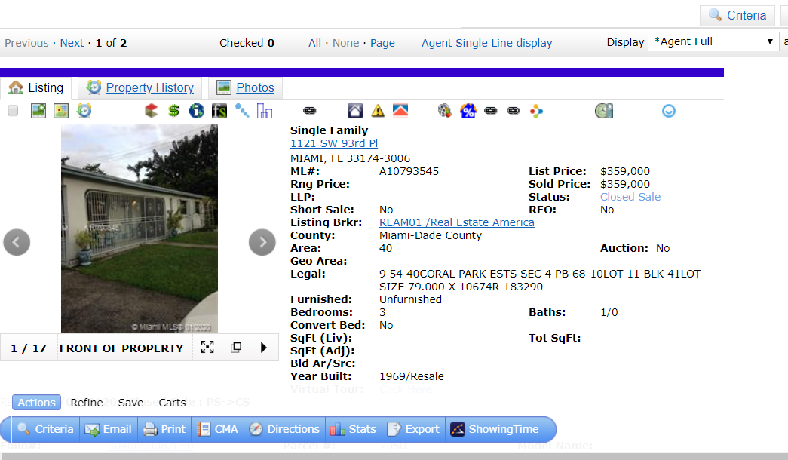
CORE LOGIC Button
IRSF01 First Service Realty

Slide 5
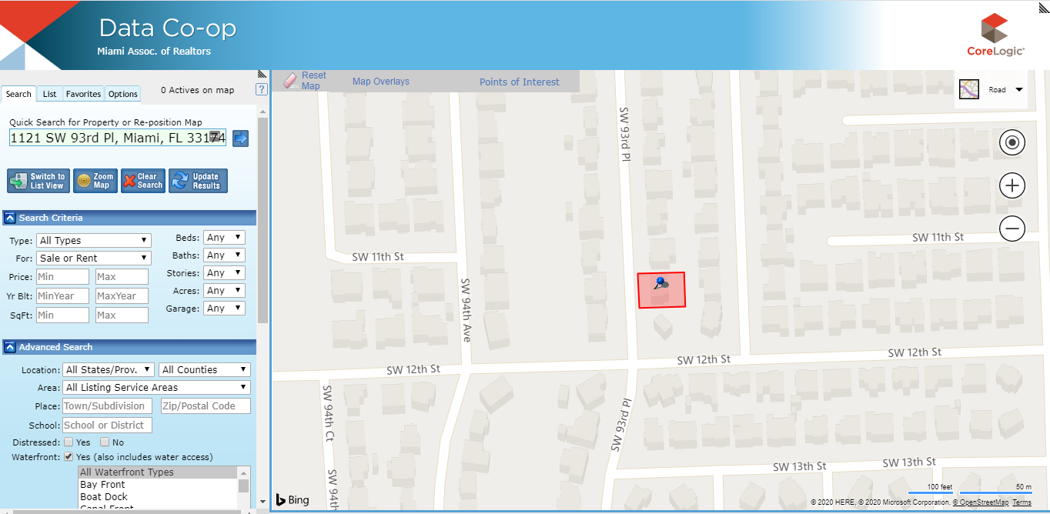
Subject

Slide 6
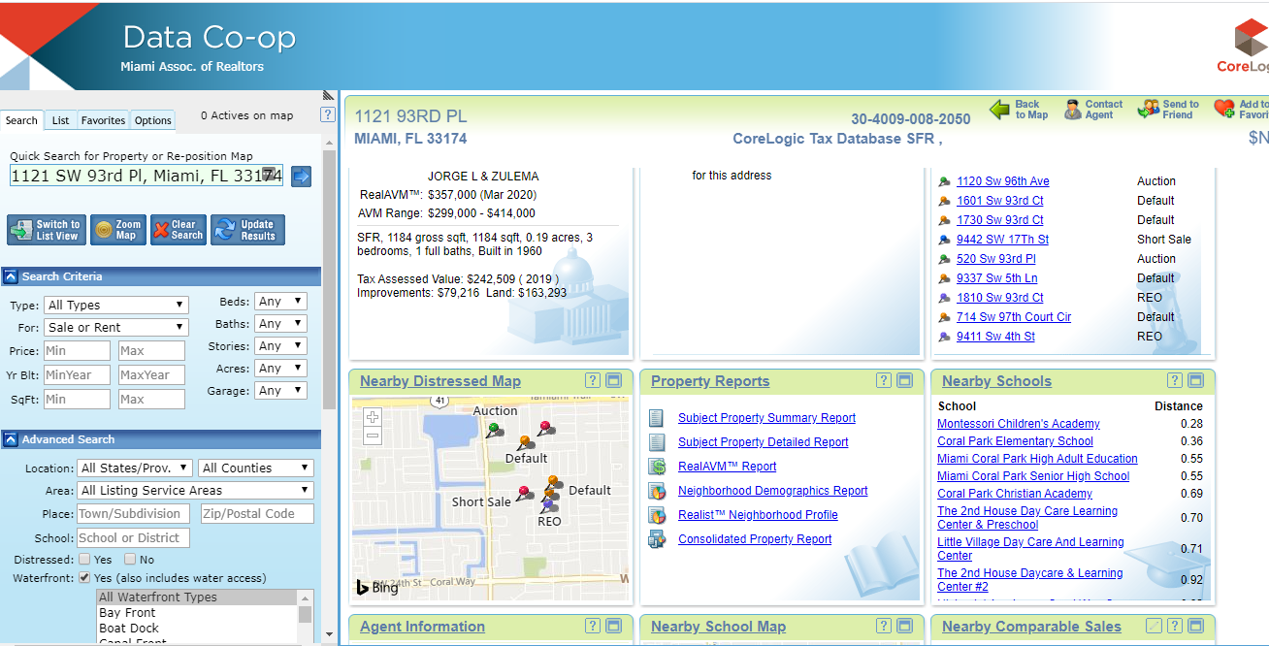

Slide 7
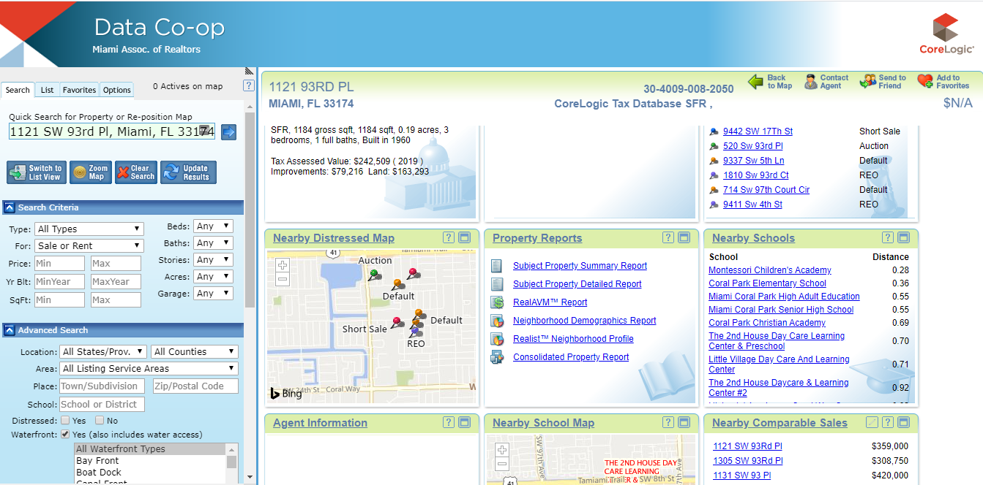
REAL AVM

Slide 8
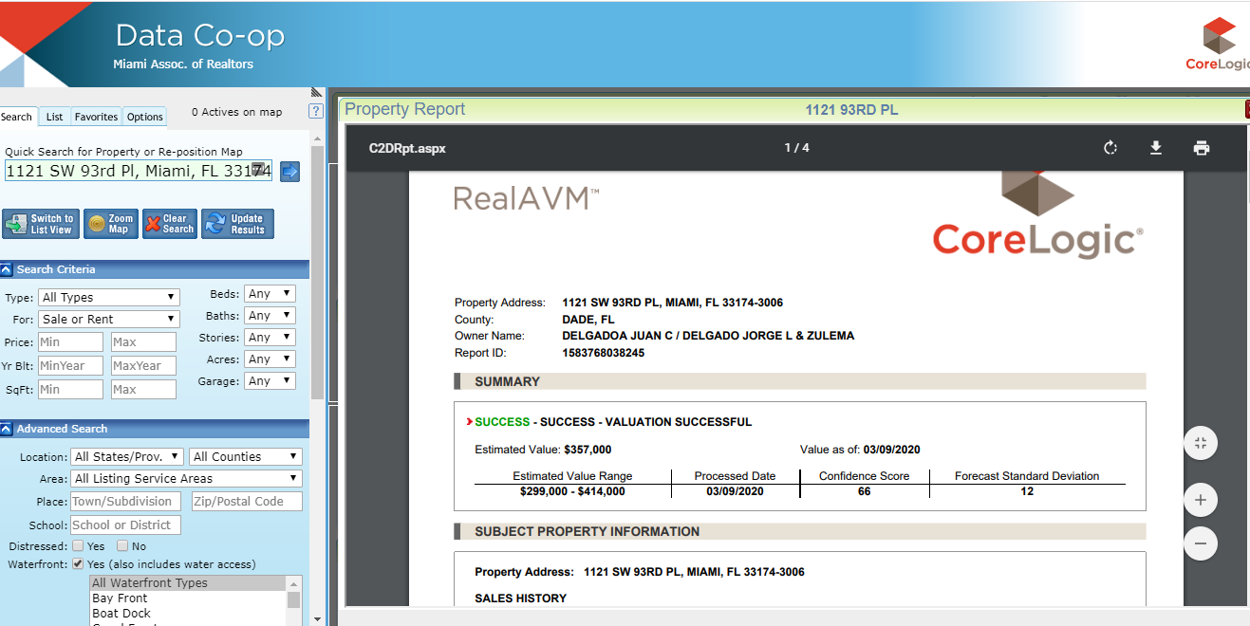
VALUE
Deviation

Slide 9
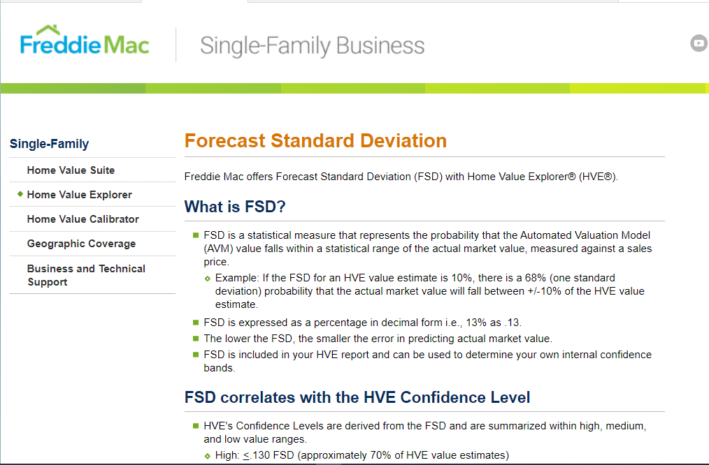

Slide 10
REPORT CLIENT

Slide 11
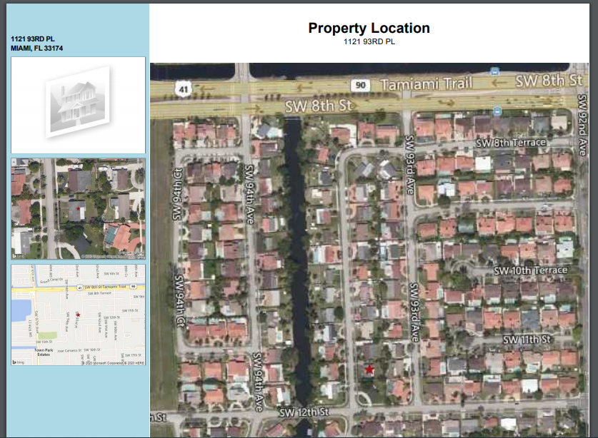
Customer report Starts Here
Page 1
Mr and Mrs Martinez
Subject

Slide 12
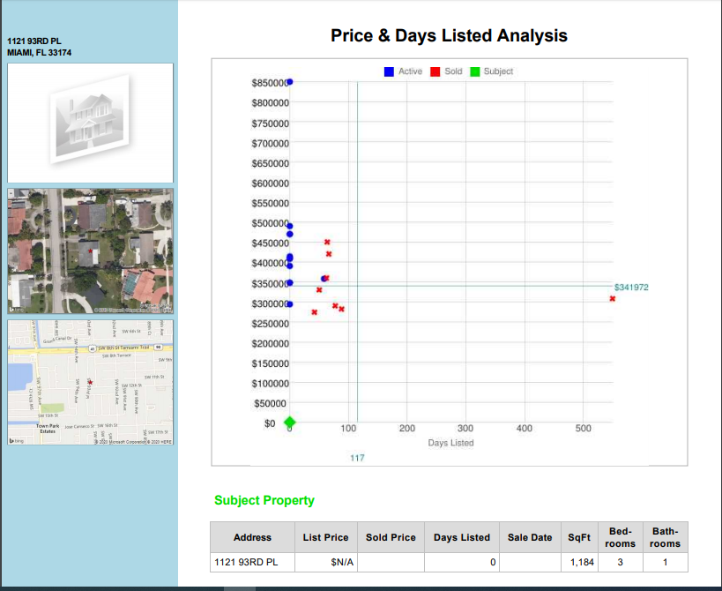
Page 2

Slide 13
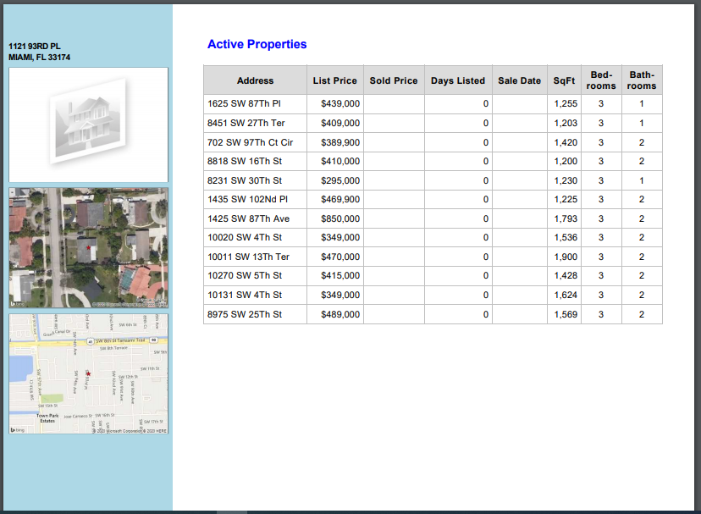
Page 3

Slide 14
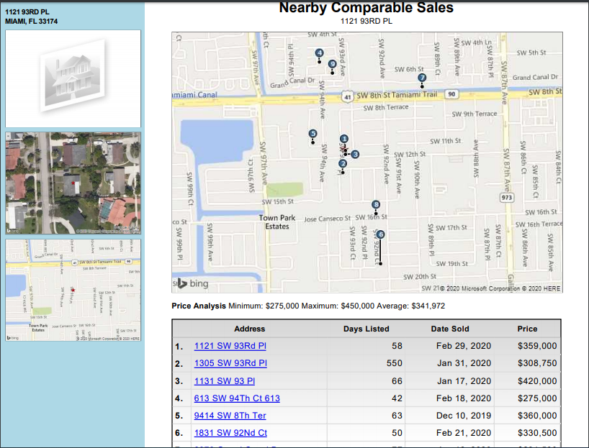
Page 4

Slide 15
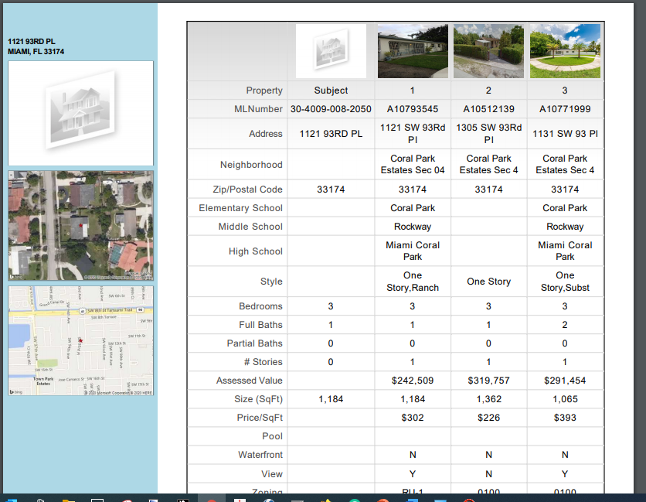
Page 5

Slide 16
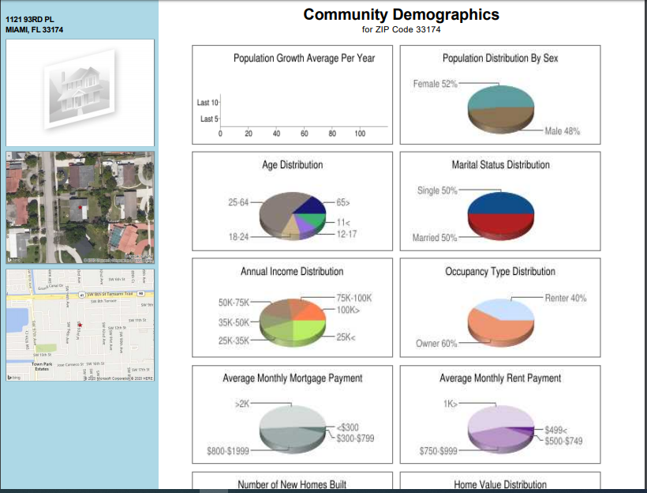
Page 6

Slide 17
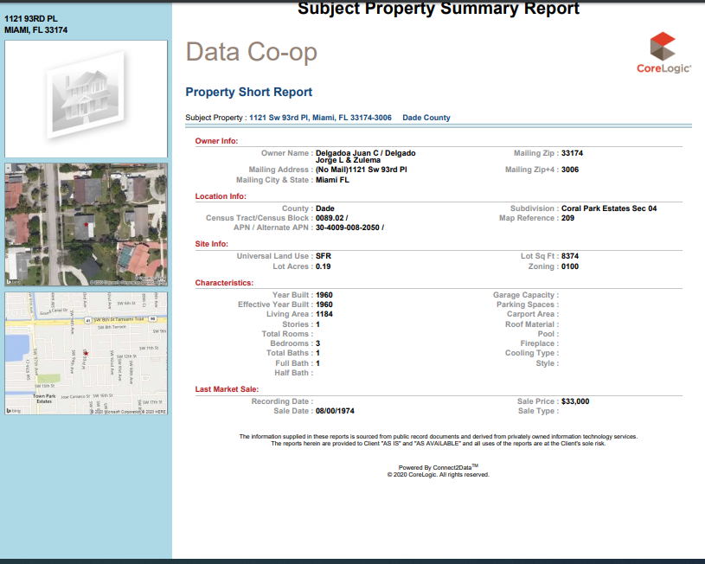
Page 7

Slide 18
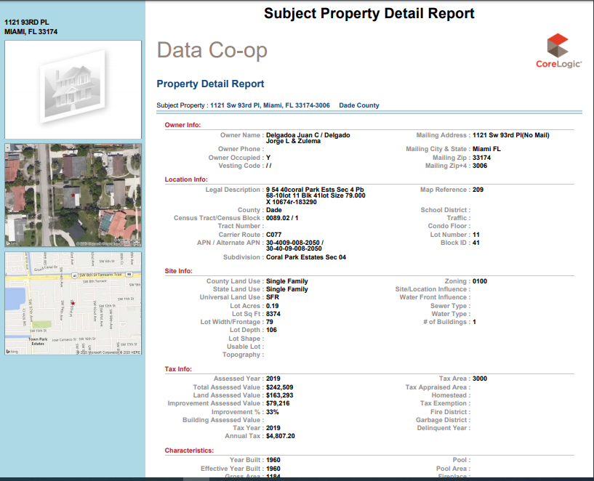
Page 8

Slide 19
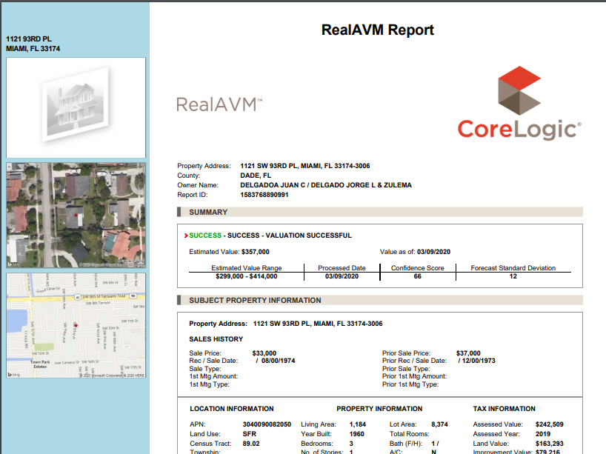
Page 9
Customer Final Page REPORT
VALUES

Slide 20
Negotiations
Final Negotiation point to go through each ERA program and close the DEAL

Slide 21
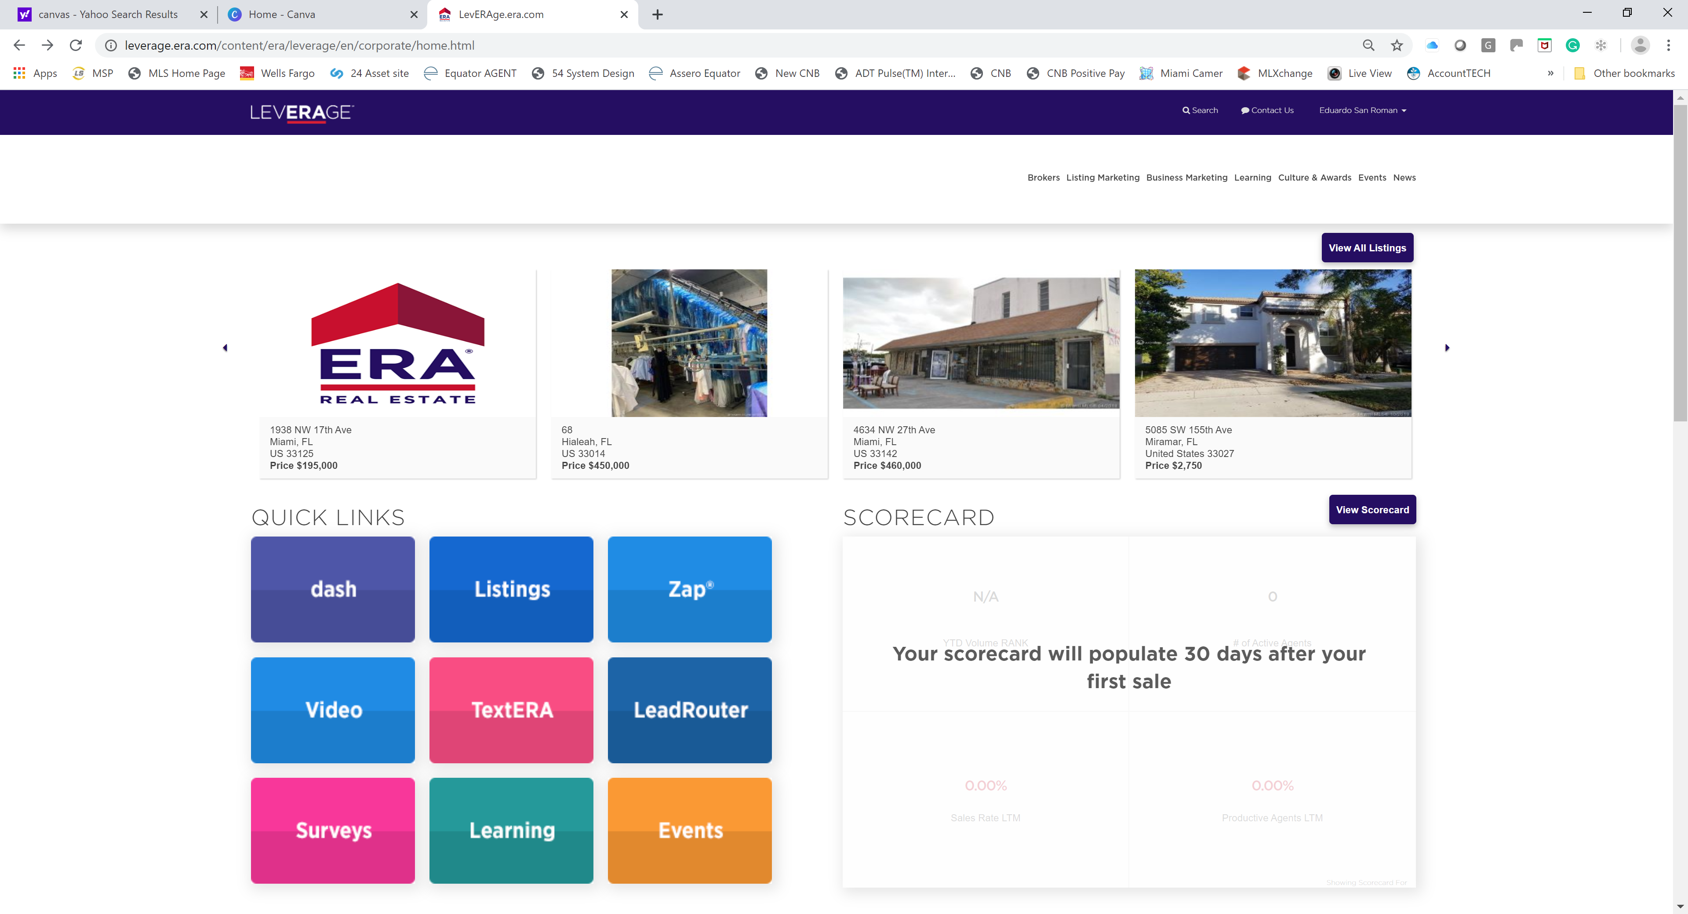
Take the Class AGAIN
Learning
Click

Slide 22
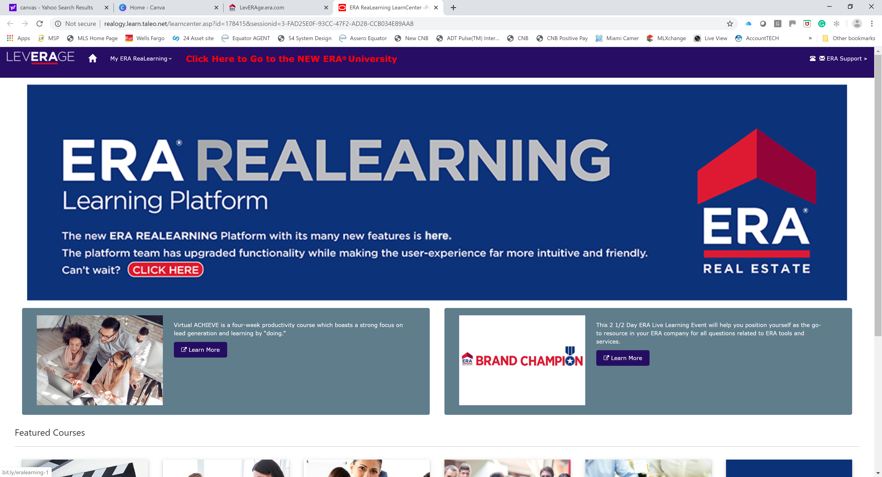
CLICK NEW ERA UNIVERSITY
Click

Slide 23
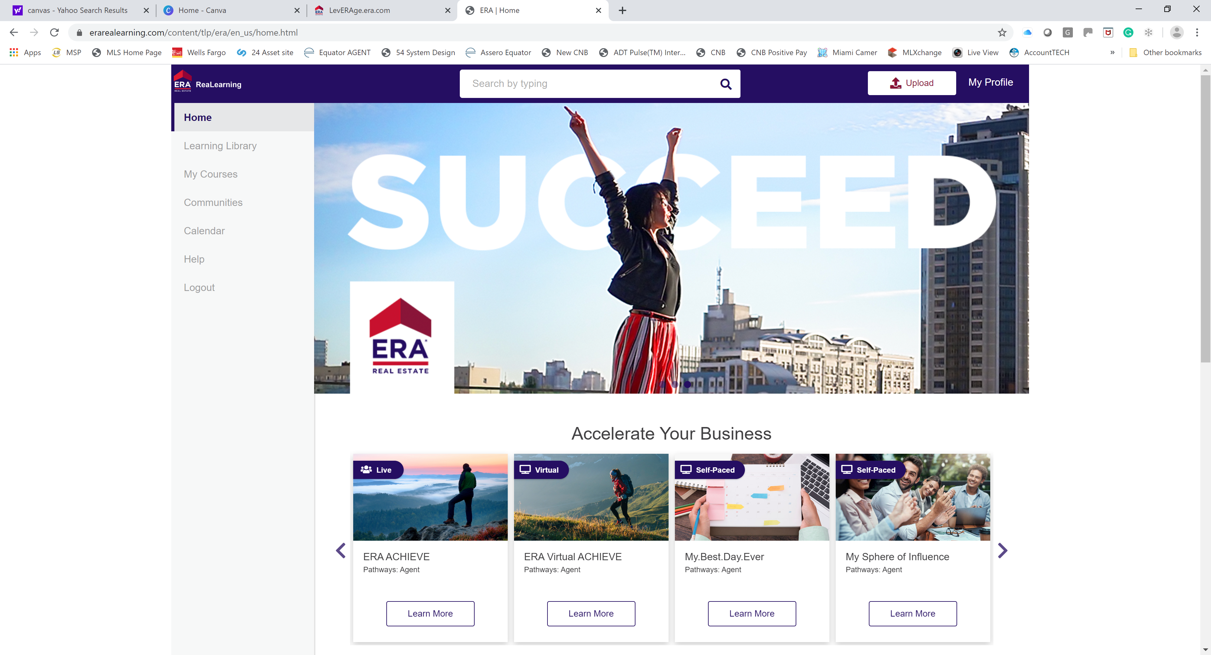
CLICK UPLOAD
Click Upload

Slide 24
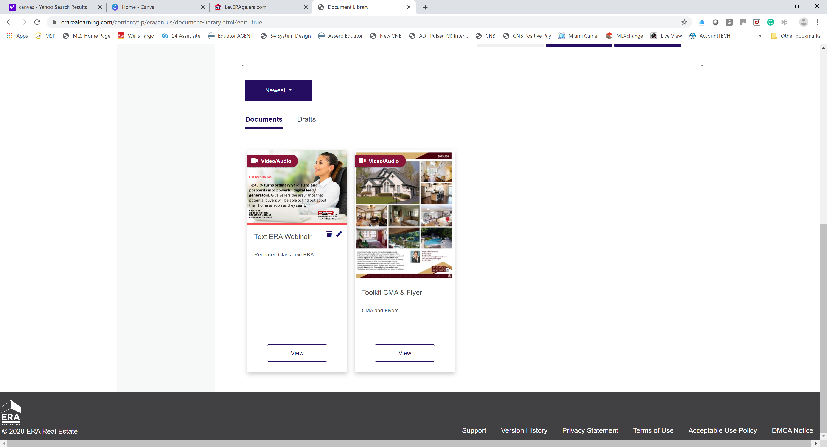
Watch the VIDEOS
Video Click

Slide 25
Our Next Presentation (LIVE) of Price is RIGHT
March 12, 2020
Adventura Office
10:30AM to 12:30 PM
March 19, 2020
Kendall Office
10:30AM to 12:30 PM
March 26, 2020
Miami Lakes Office
10:30AM to 12:30 PM
March 26, 2020
Hollywood Office
2:00 PM to 4:00 PM
Notes:
Selling Your Property: Pricing – Fair Market Value
This is a term you may have heard, Fair Market Value. Fair Market Value is a price that a ready, willing and able buyer is willing to pay and a seller is willing to accept. The reason it is important that we accurately project Fair Market Value is because if we end up pricing too far away from Fair Market Value, your house won’t sell. Let’s discuss how we can accurately project what Fair Market Value will be for your house.

Slide 26
Thank you for attending
Reach us on Skype or
Support@fsr-era.com
CLOSE CLOSE CLOSE

